Slide 1

Free Electrons and Molecules —
a Lifelong Passion
Michael Allan
University of Fribourg
Switzerland
(emeritus)
DAMOP 2020
<number>
<number>
Notes:
<number>
<number>

Slide 2
Nostalgic memories of early times
Electronic excitation by electron impact on noble gasses and molecules
Nonadiabatic effects in resonances
2D EELS → dynamics of negative ion resonances (2015-2016)
<number>
<number>
Notes:
<number>
<number>

Slide 3
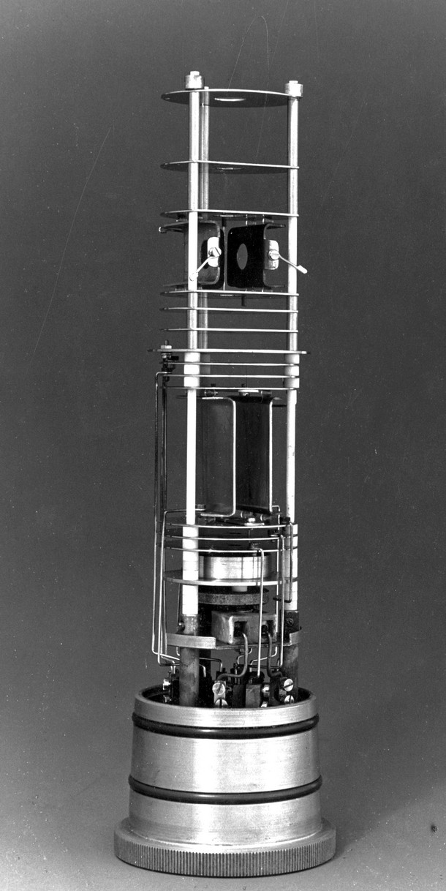
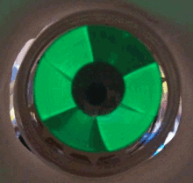
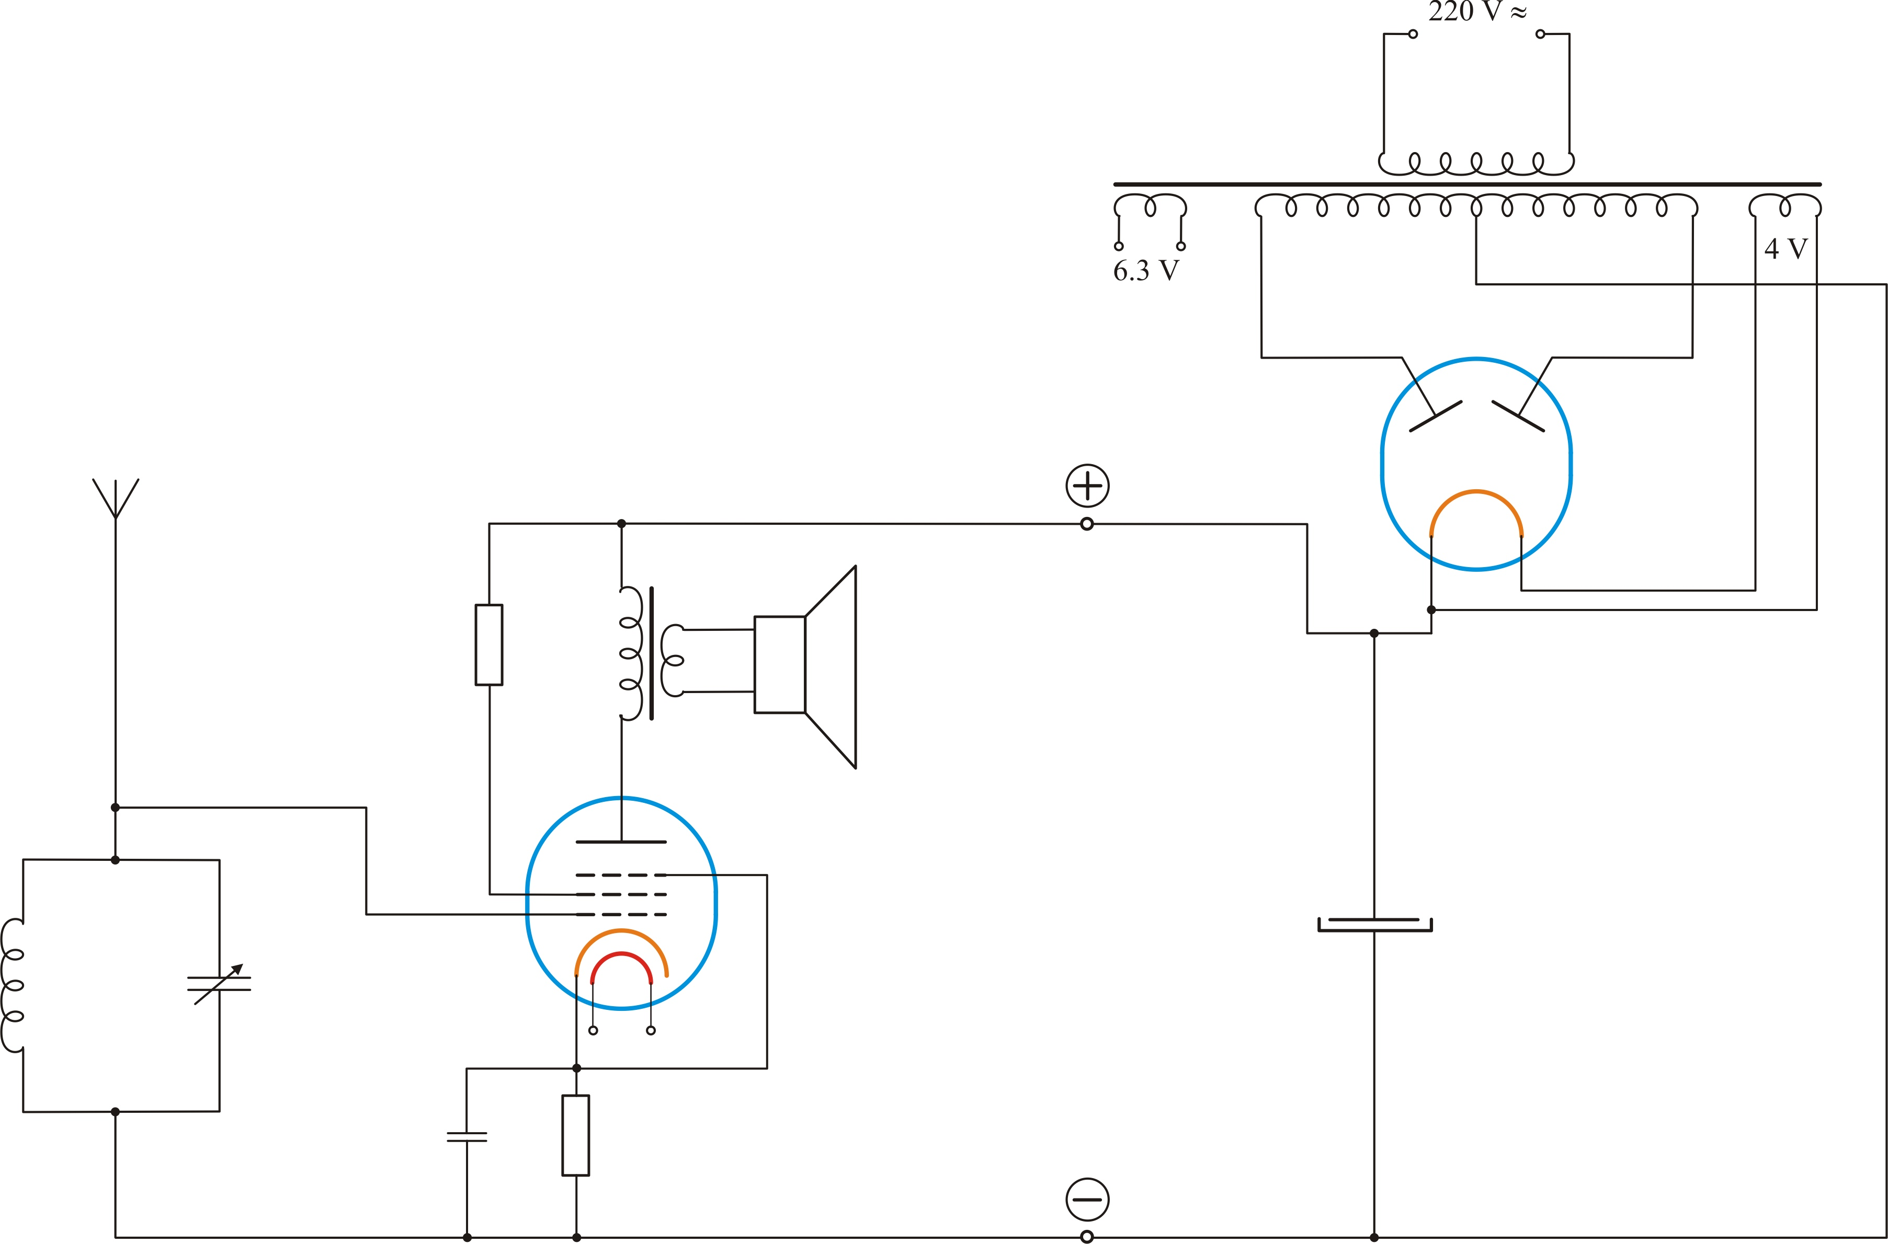
Lifelong?
High school
PhD work in Basel
magic eye
John P Maier

Slide 4
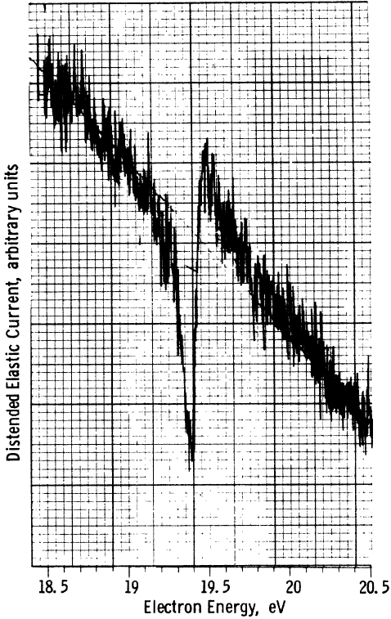
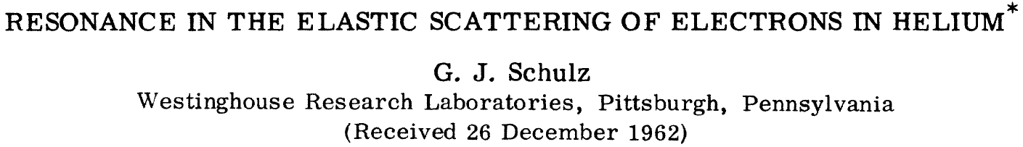
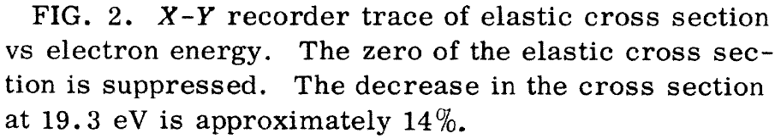
George Jiří Schulz
He 1s2s²
θ = 72°
1976
<number>

Slide 5
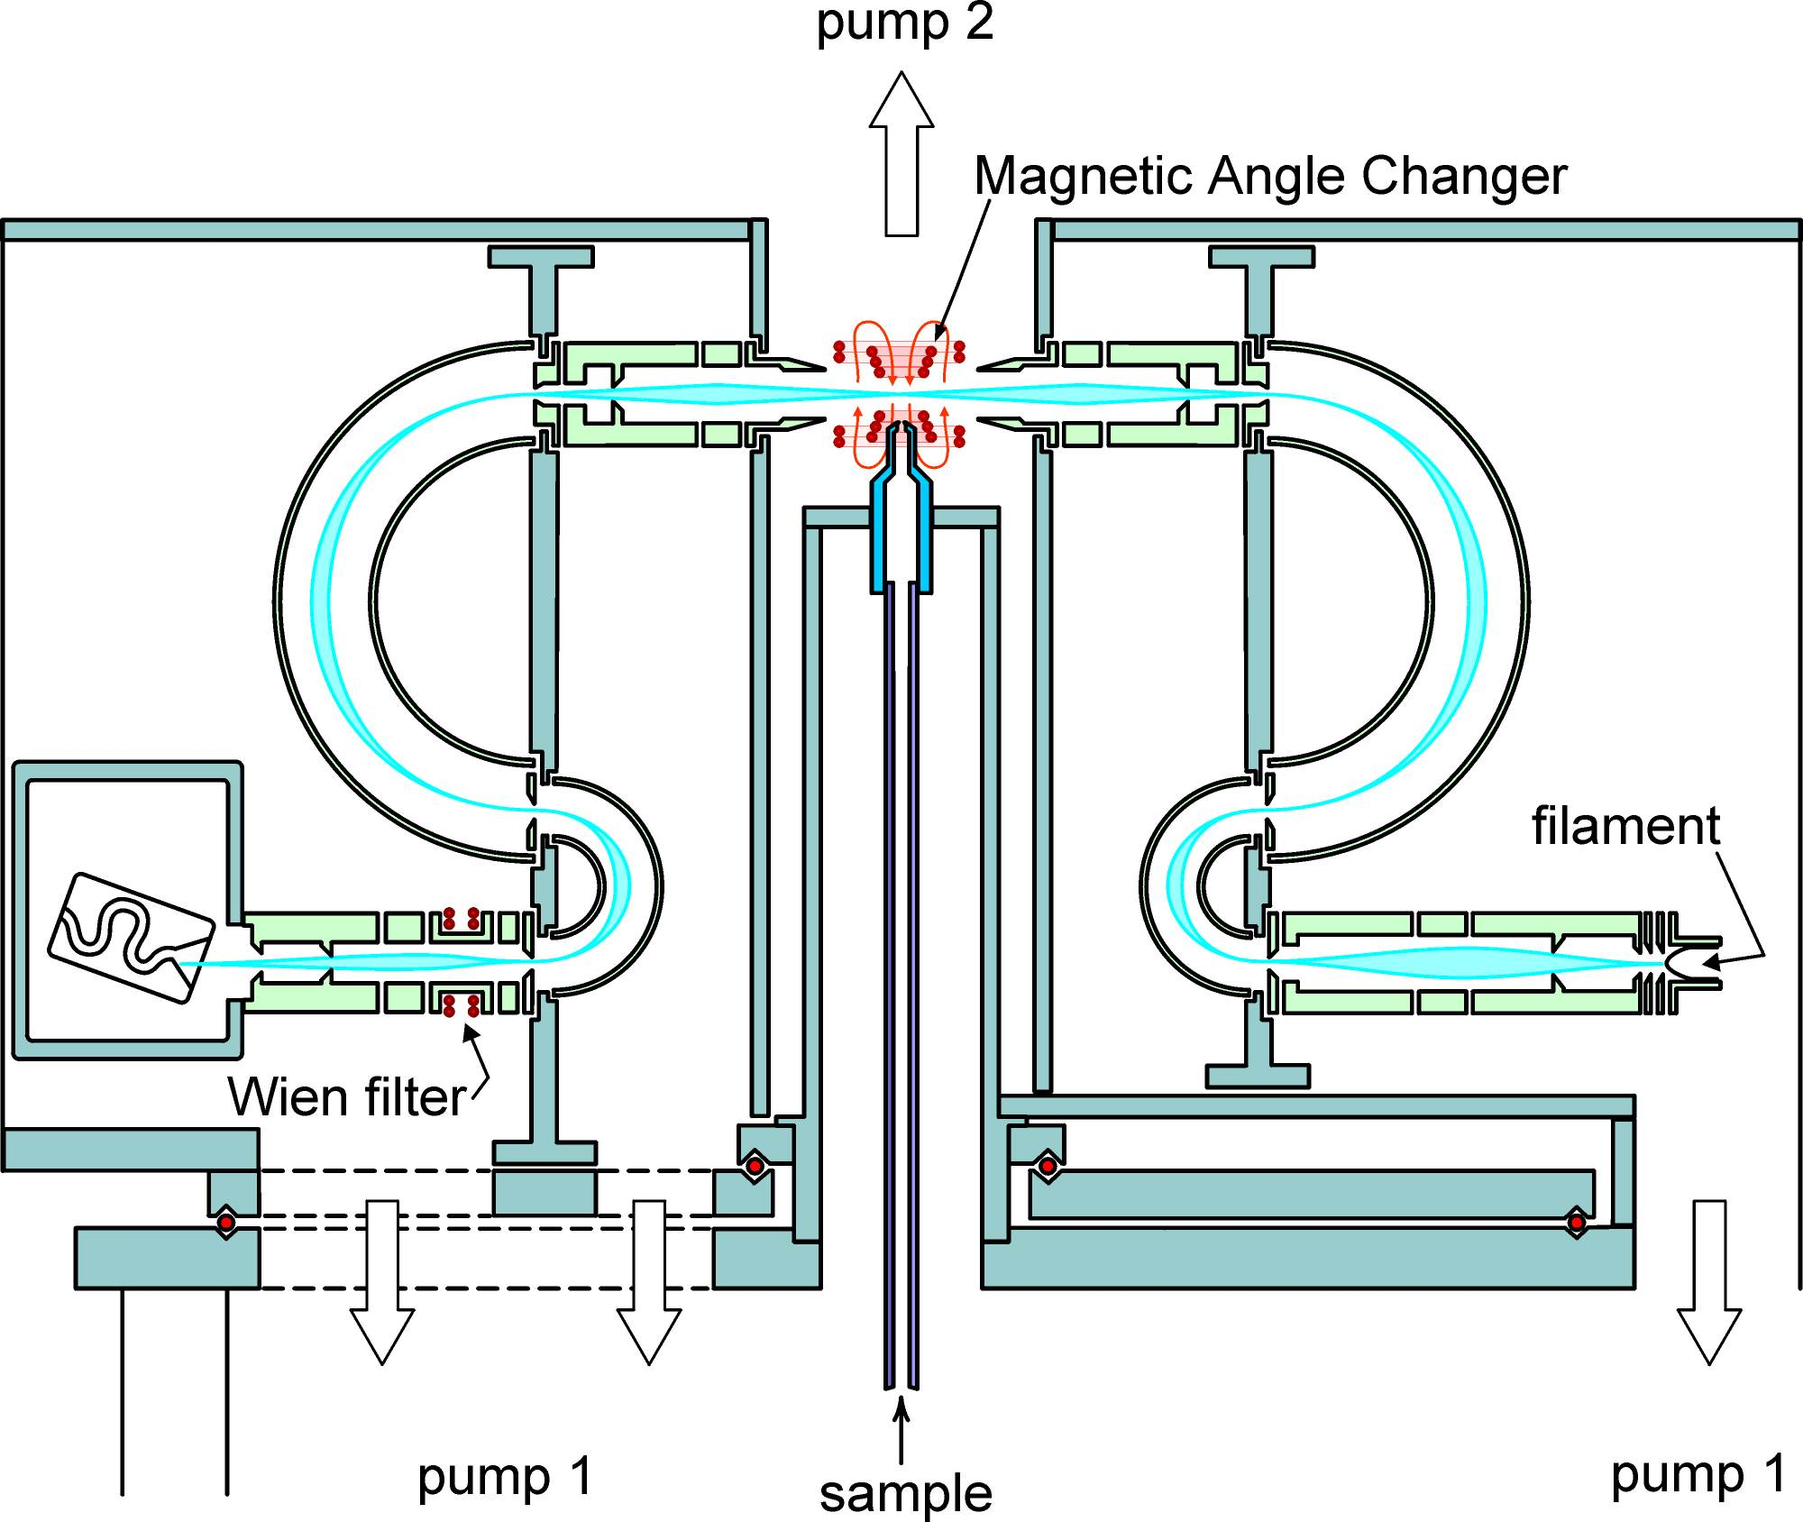
The Electron Impact Spectrometer of my dreams
<number>

Slide 6
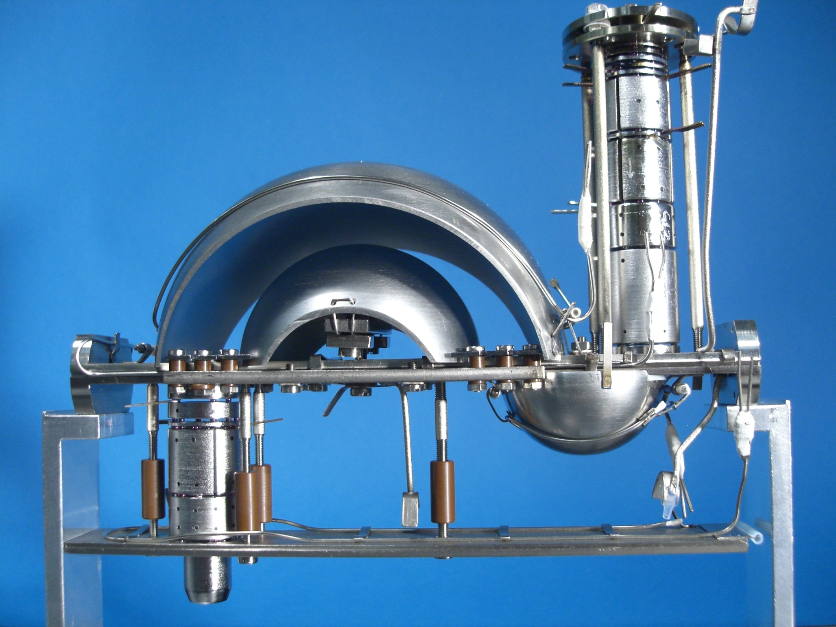
<number>

Slide 7
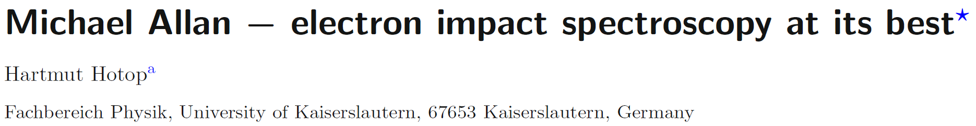
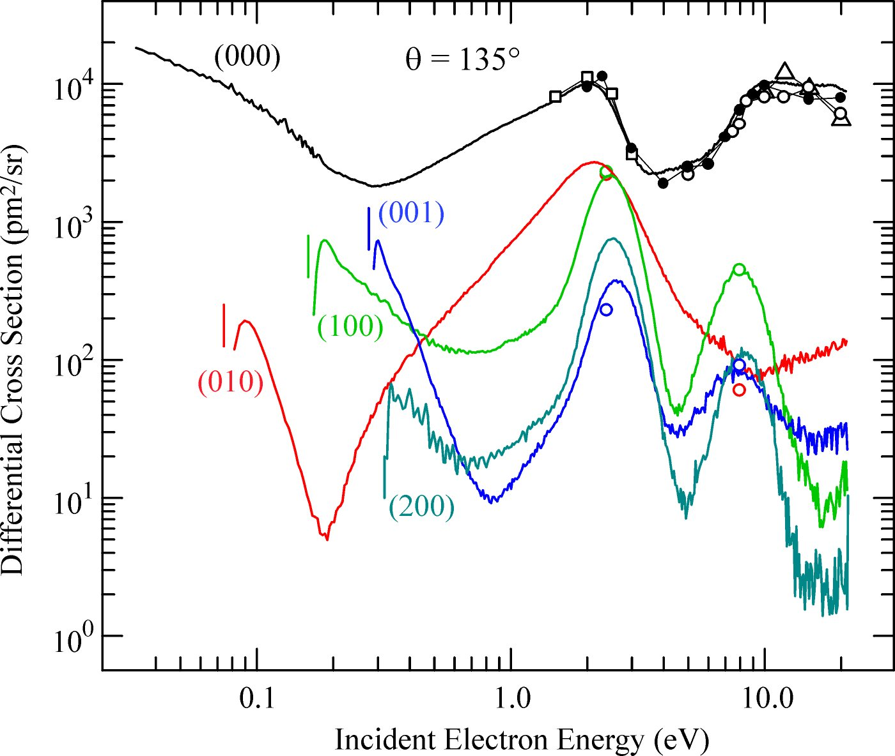
Eur. Phys. J. D (2016)
Editorial on the occasion of my retirement
N₂O
Marinković, Szmytkowski, Pejčev, Filipović and Vuškoviš (1986)
Johnstone and Newell (1993)
Kitajima, Sakamoto, Gulley, Hoshino, Gibson, Tanaka and
Buckman (2000)
M. Allan and T. Skalický, J. Phys. B 2003
<number>

Slide 8
Electronic excitation by electron impact on noble gasses
Klaus Bartschat
Oleg Zatsarinny
(in the footsteps of Julie M Phillips)
<number>
<number>
Notes:
<number>
<number>

Slide 9
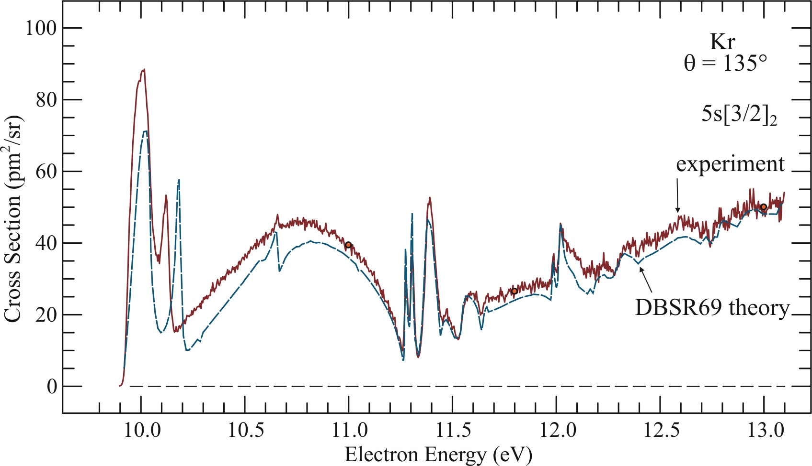
Kr
Absolute cross sections for excitation of the Kr (4p⁵5s) states:
high-resolution electron scattering experiments and B-spline
R-matrix calculations.
M. Allan, O. Zatsarinny, and K. Bartschat, J. Phys. B 44, 065201 (2011)
<number>

Slide 10
Electronic excitation in molecules
Jimena Gorfinkiel
Alexandra Loupas
Zdeněk Mašín
Localization of S-matrix poles in the complex energy plane using the molecular R-matrix method
Thursday M5.7
Romarly Da Costa
<number>
<number>
Notes:
<number>
<number>

Slide 11
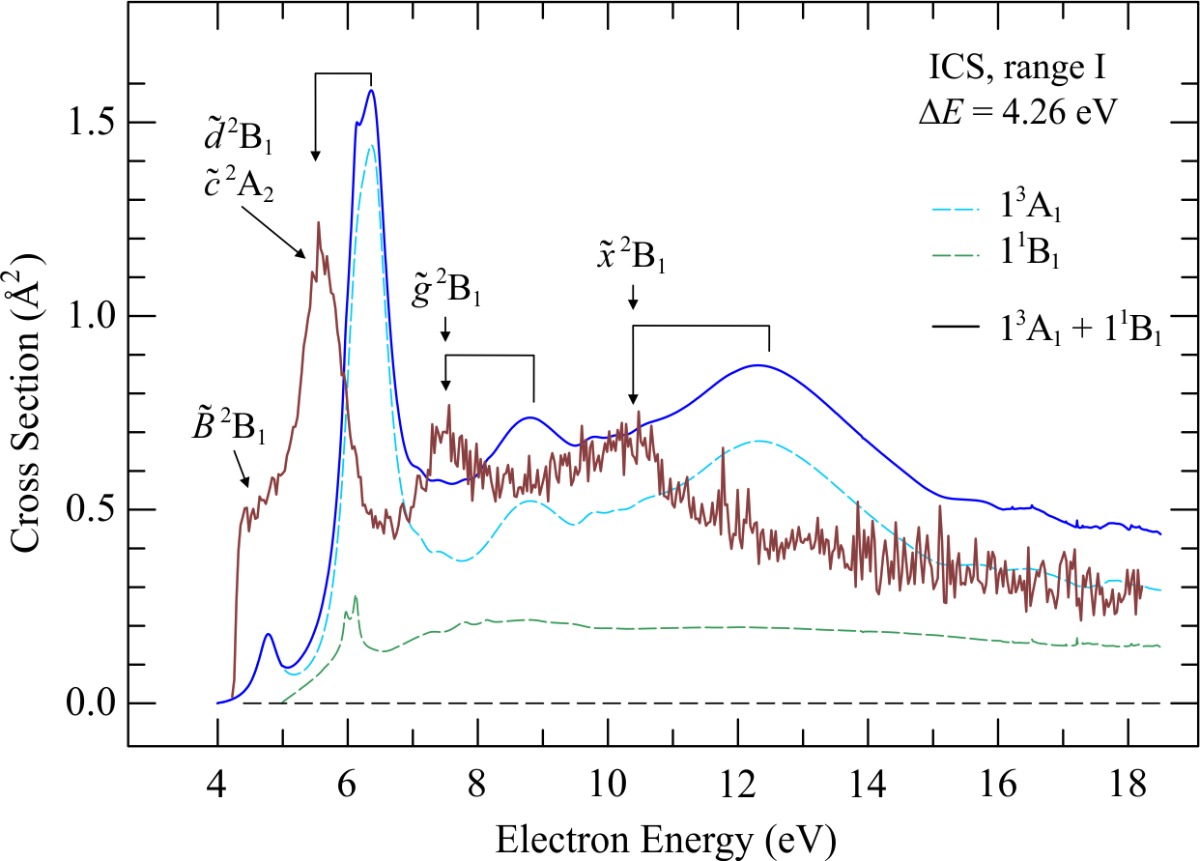
Pyrimidine
Khrystyna Regeta, Michael Allan, Zdeněk Mašín, and Jimena D. Gorfinkiel
J. Chem. Phys. 2016
<number>

Slide 12
Nonadiabatic effects in resonances
Ilya Fabrikant
(magic resonances where I would never expect them)
H. Ambalampitiya, I.I. Fabrikant,
Quantum and semiclassical cross section of dissociative electron attachment to polyatomic molecules.
Thursday, Session M5.9
<number>
<number>
Notes:
<number>
<number>

Slide 13
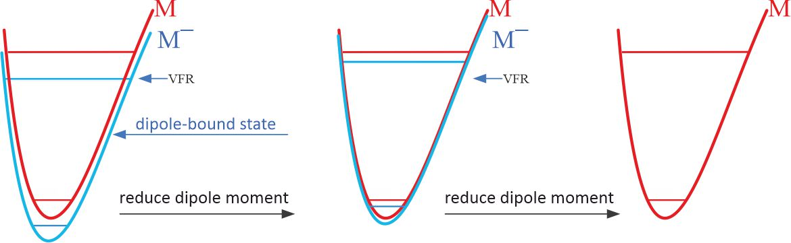
Dipole-bound states
<number>
<number>
Notes:
<number>
<number>

Slide 14
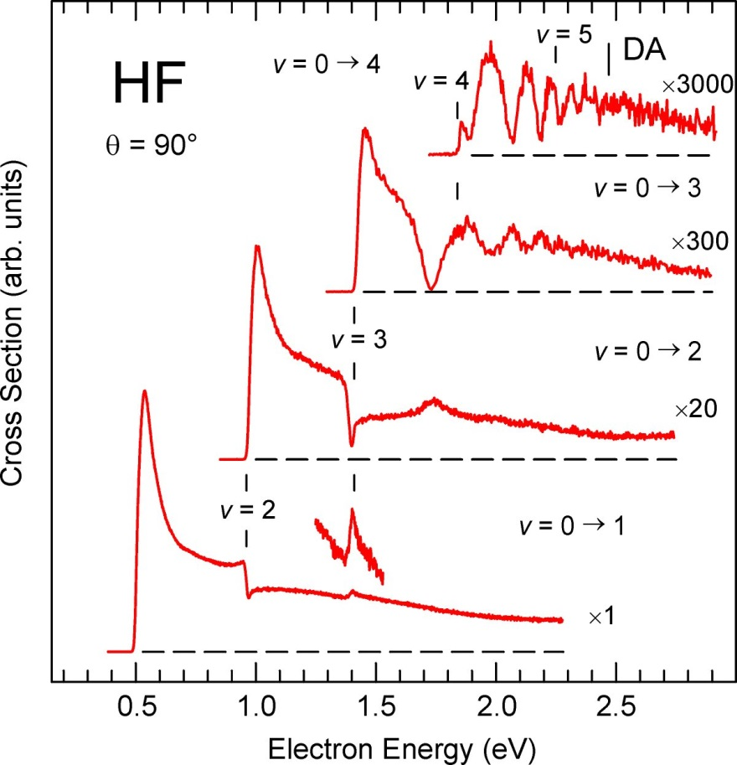
μ = 1.83 D - subcritical

Slide 15
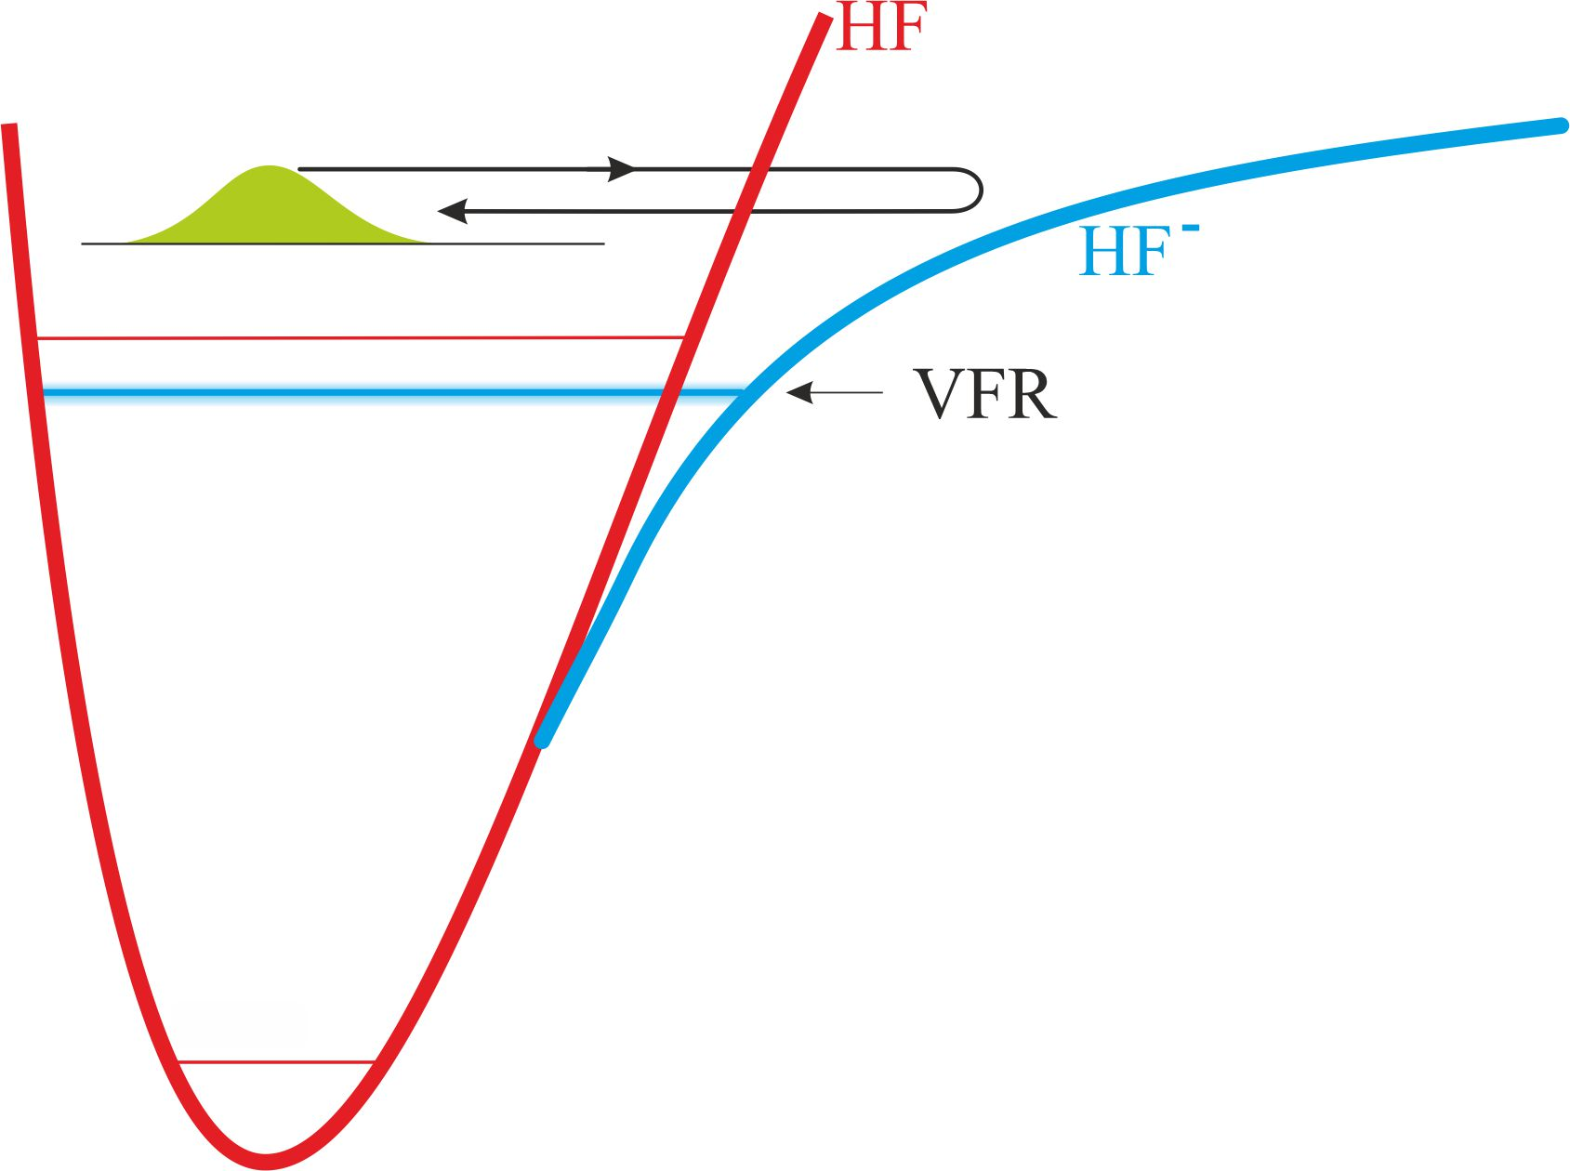
Dipole-bound states
<number>
<number>
Notes:
<number>
<number>

Slide 16
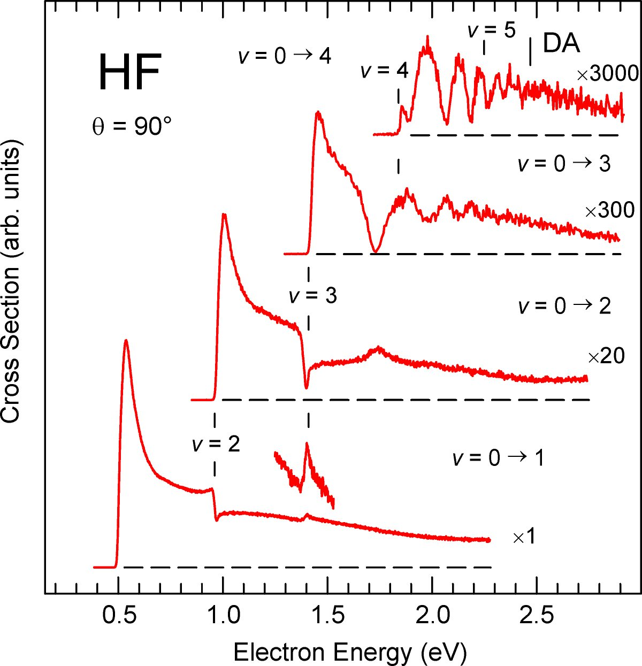
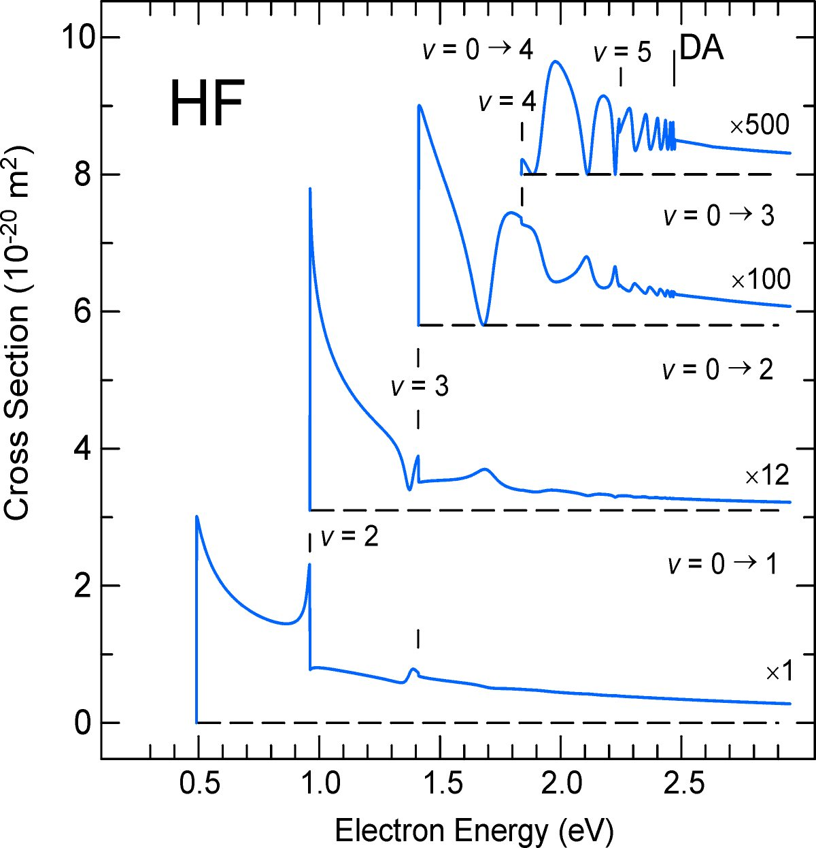
Vibrational excitation in hydrogen fluoride: experiment and theory
μ = 1.83 D
Martin Čížek, Jiří Horáček, Michael Allan, Ilya I. Fabrikant and Wolfgang Domcke 2003

Slide 17
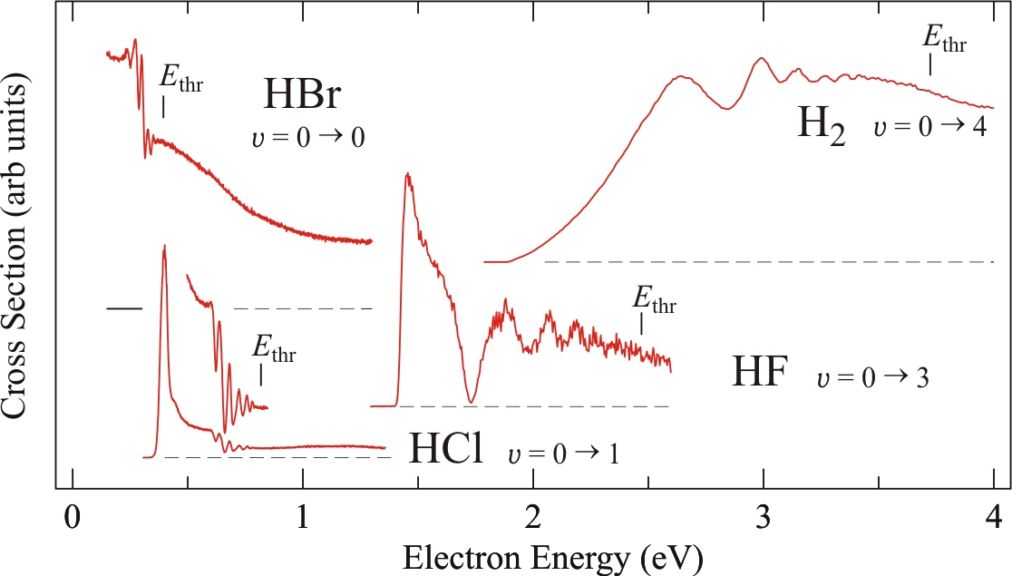

Slide 18
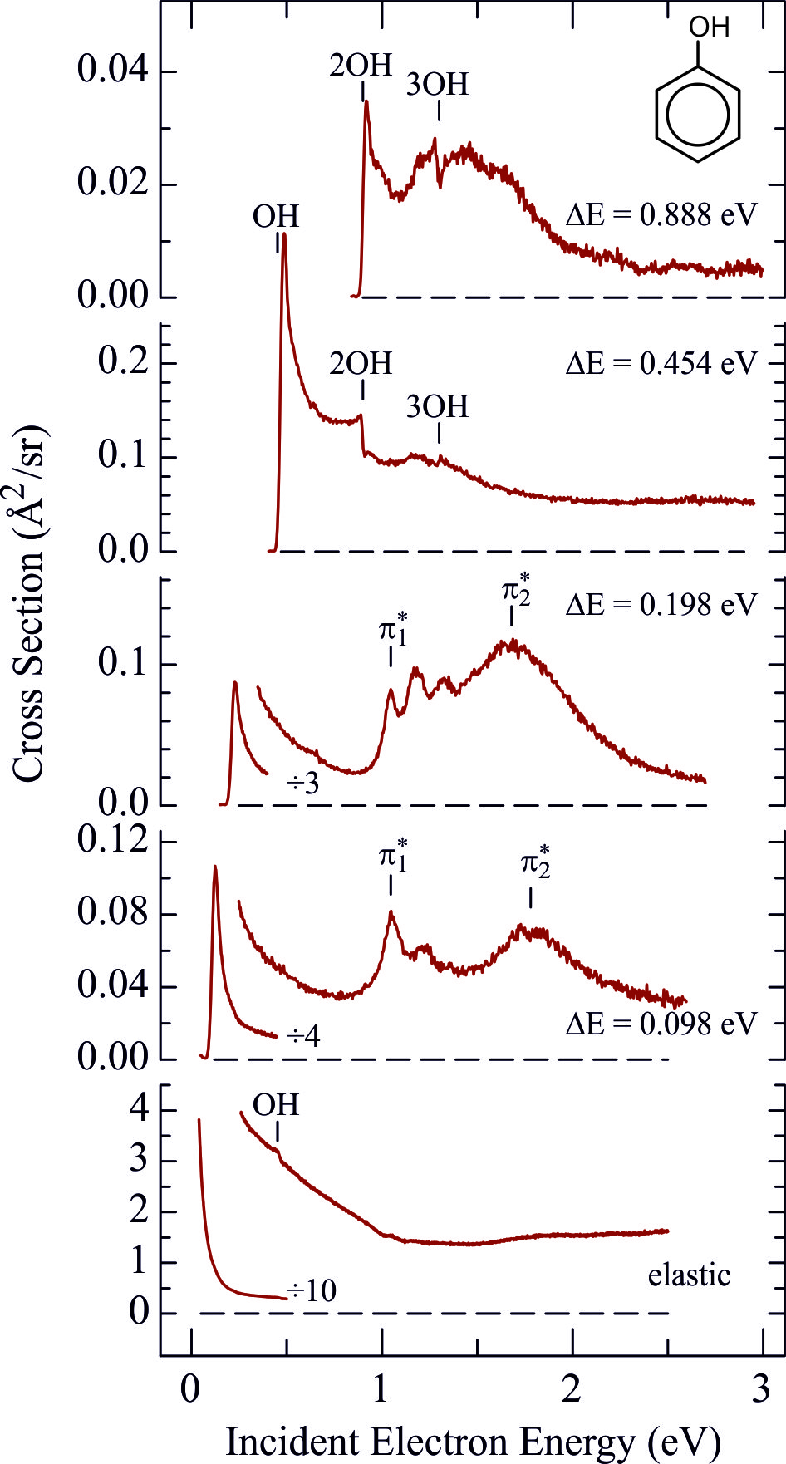
observe the amazing similarity between
O-H stretch and F-H stretch!
<number>

Slide 19
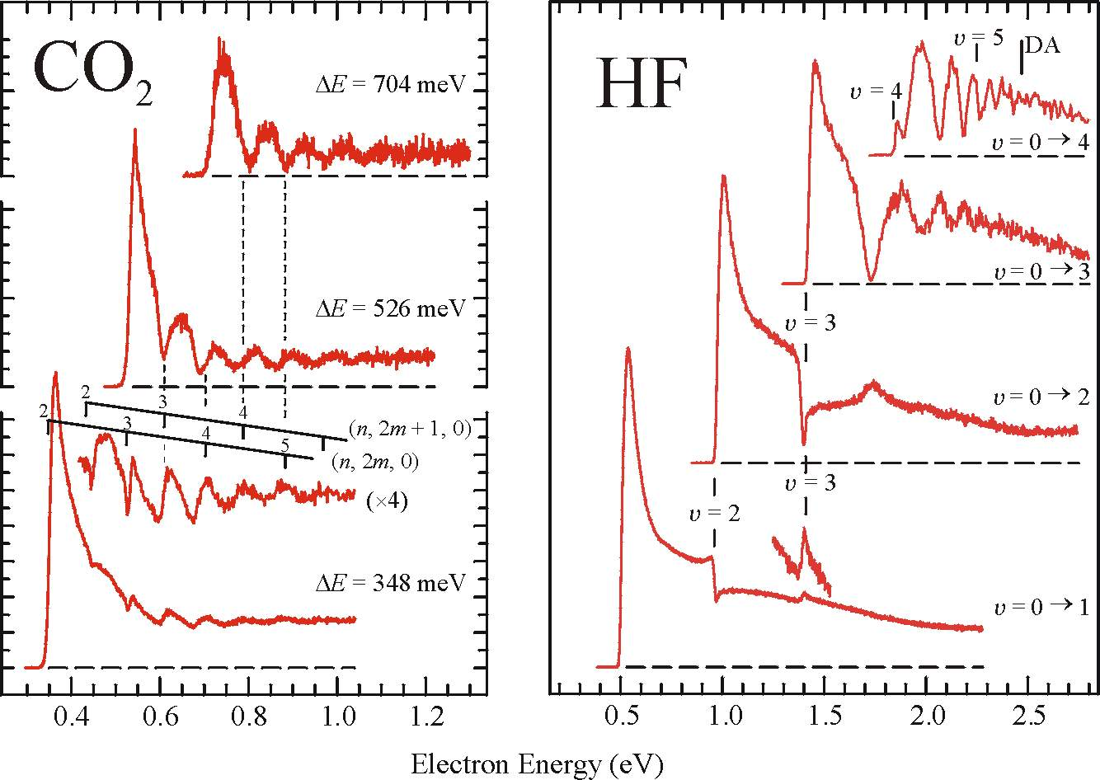
Similarity of vibrational cross sections in CO₂ and HF
μ = 0 D
μ = 1.8 D

Slide 20
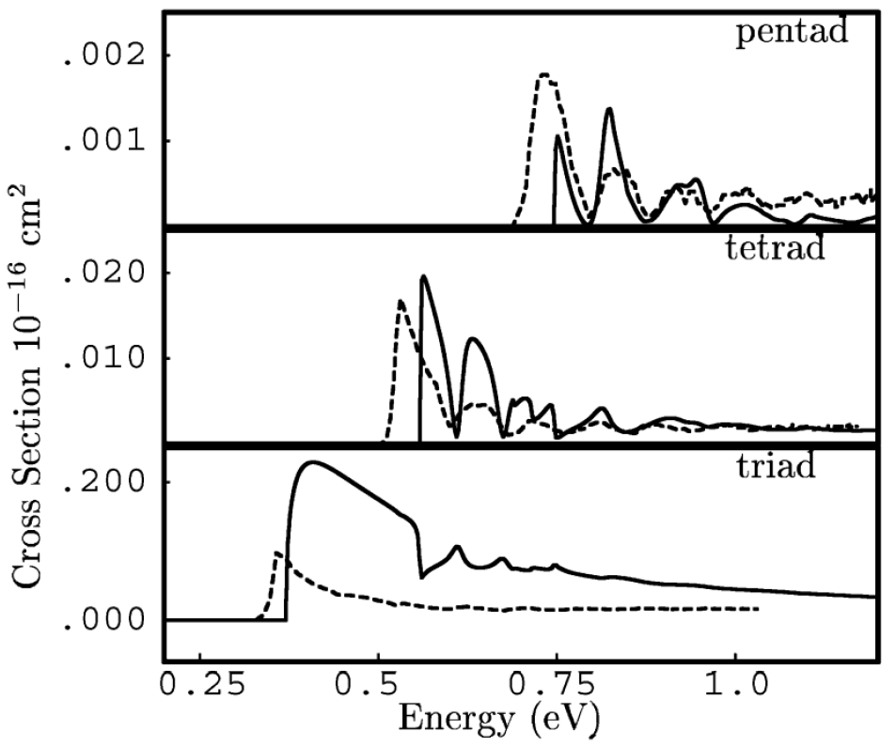
Theory for CO₂
Wim Vanroose, Zhiyong Zhang, C.W. McCurdy, and T. N. Rescigno
Phys. Rev. Lett. 2004
Daniel Slaughter
Thorsten Weber
Ali Belkacem
Robert Lucchese
Cynthia Trevisan
C. William McCurdy
Thomas Rescigno
"Nonadiabatic dynamics in dissociative electron attachment to formic acid"
the presence of a conical intersection between two metastable anion potential energy surfaces
Poster Session E01.00023

Slide 21
2-dimensional Electron Energy Loss Spectra → dynamics of negative ion resonances

Slide 22
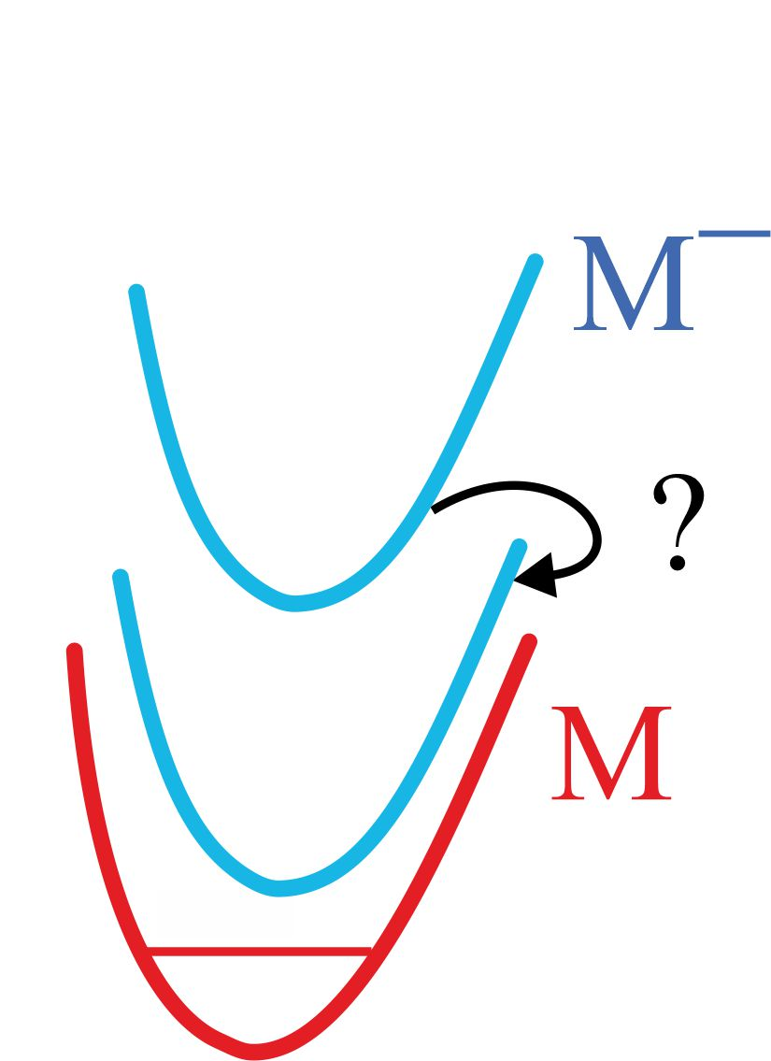
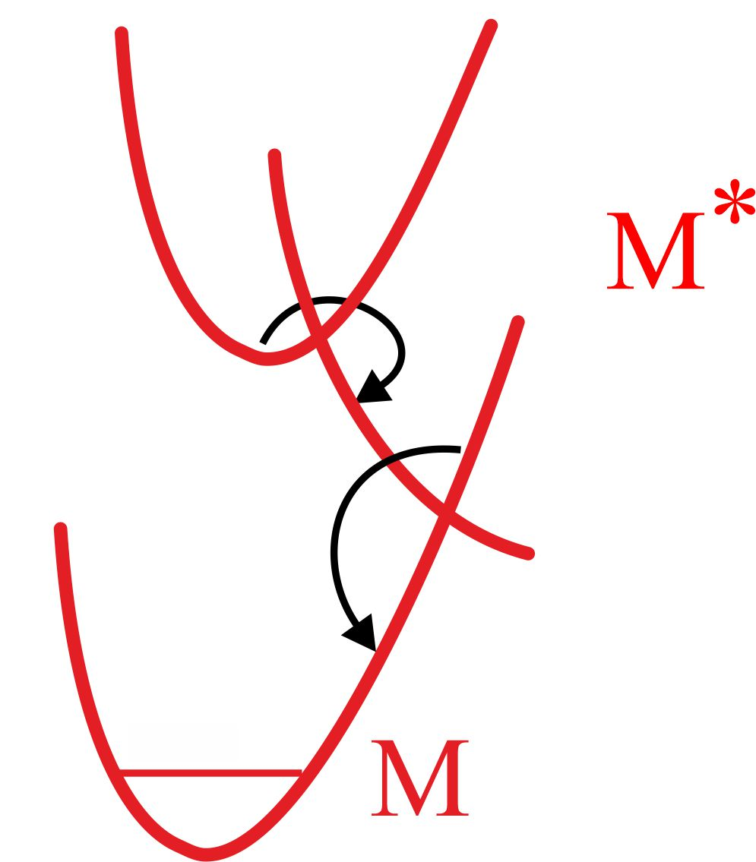
dynamics ?
Photochemistry
Resonances ?
conical intersections
Part of the motivation:
Extending quantum chemistry of bound states to electronic resonances
Anna Krylov, Ksenia Bravaya, Thomas Jagau
Neutral molecule dynamics at this conference:
Martin Centurion "Imaging dynamics in complex molecules with ultrafast electron diffraction"
Tuesday Session C 4.1
early theory
H. Estrada, L. S. Cederbaum, and W. Domcke
(1986)
Alternative: 2D anion photoelectron (PE) spectroscopy
Jan R. R. Verlet, Durham University

Slide 23
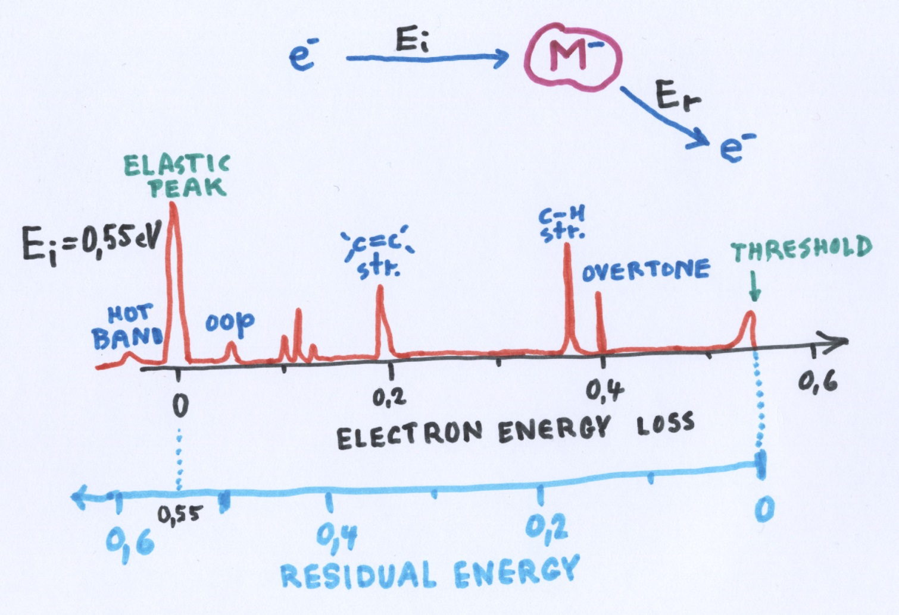
Electron Energy Loss Spectrum
<number>
<number>
Notes:
<number>
<number>

Slide 24
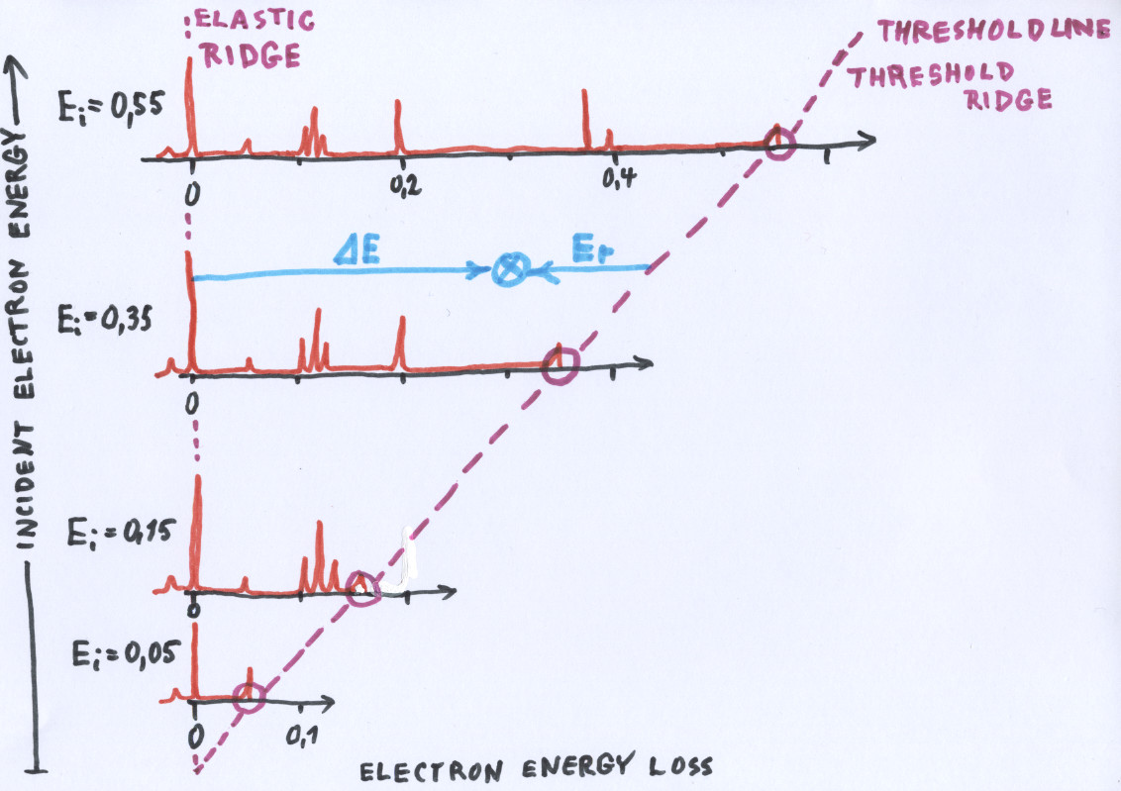
Two-dimensional
Electron Energy Loss Spectrum
<number>
<number>
Notes:
<number>
<number>

Slide 25
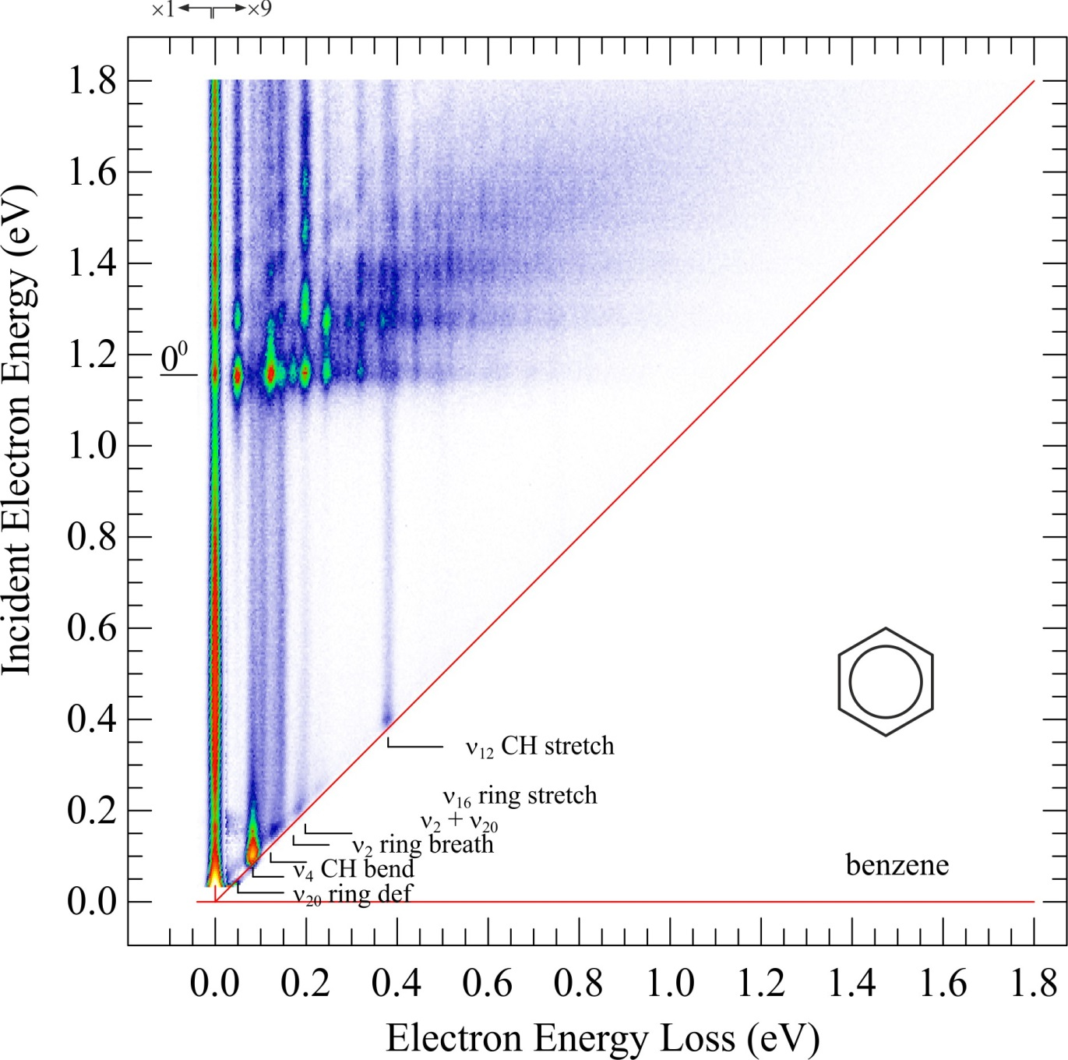
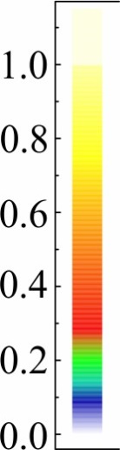

<number>
<number>
Notes:
<number>
<number>

Slide 26

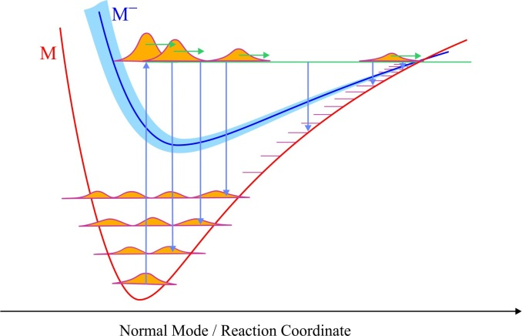
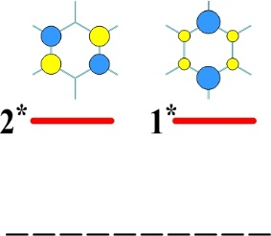
pump & probe experiment!
<number>
<number>
Notes:
<number>
<number>

Slide 27
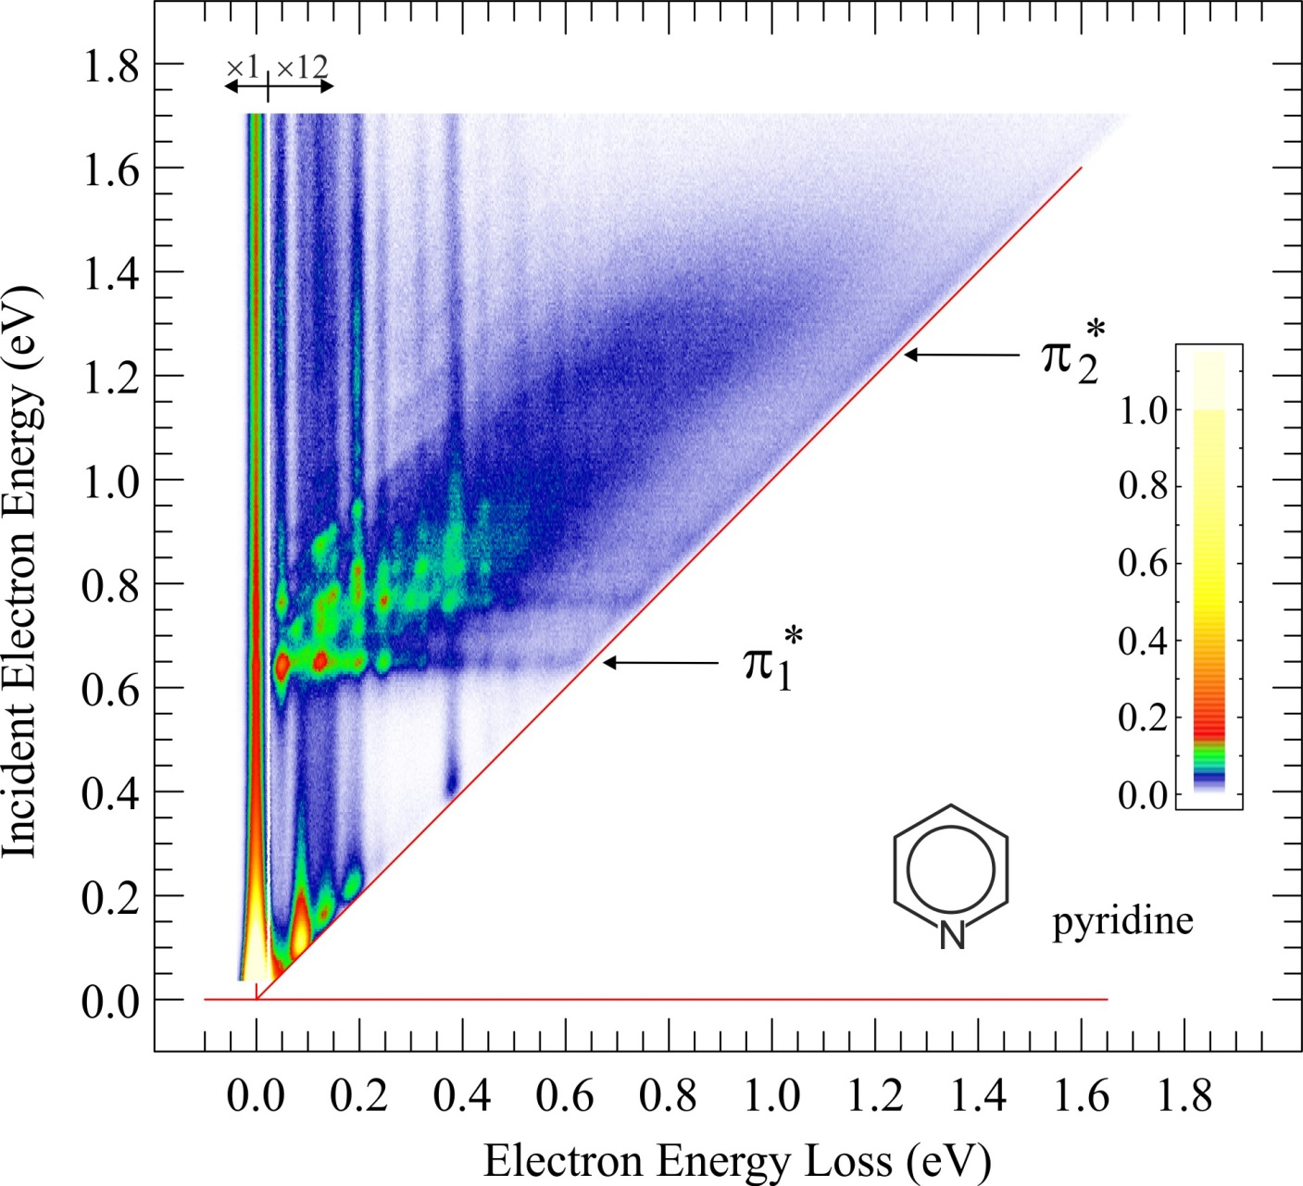
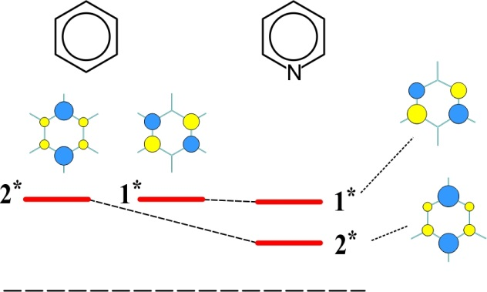
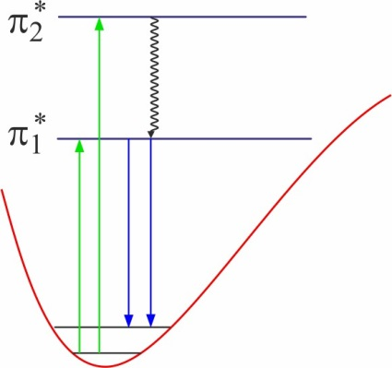
Pyridine
μ = 2.2 D
Kasha’s rule
<number>
<number>
Notes:
<number>
<number>
<number>

Slide 28
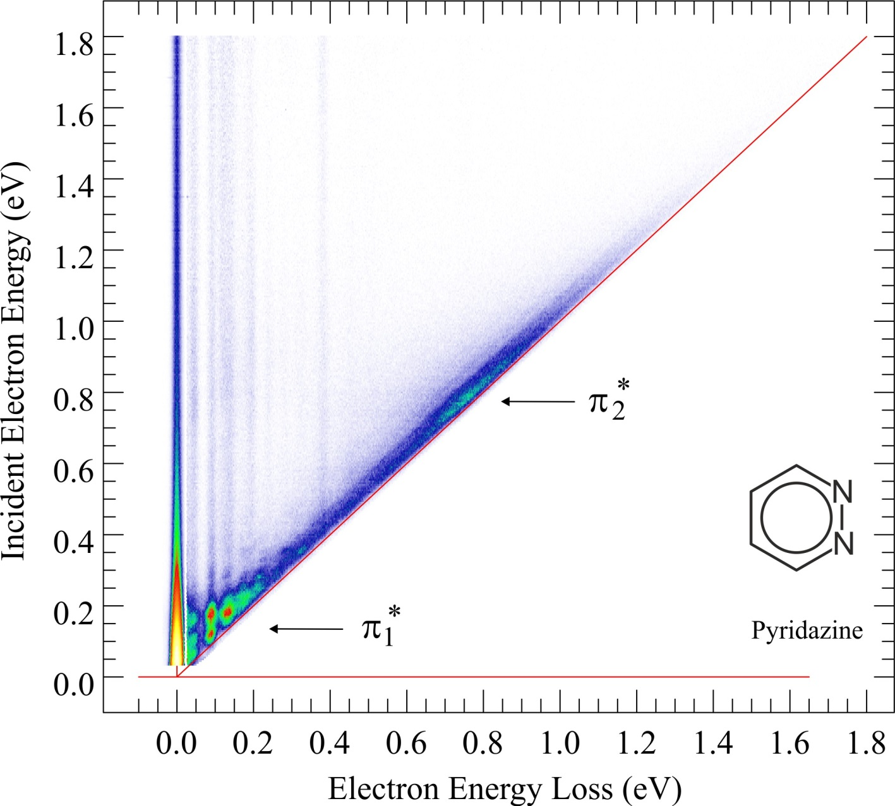
Pyridazine
« supersponge »
The capacity to thermalize electrons reveals a conical intersection !
<number>
<number>
Notes:
<number>
<number>

Slide 29
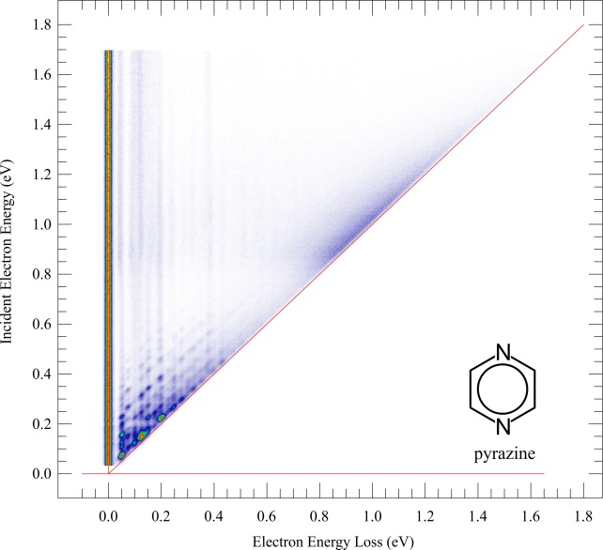
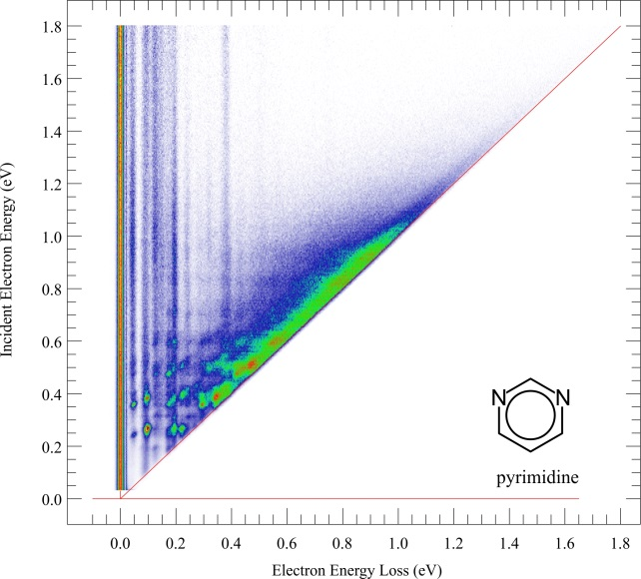
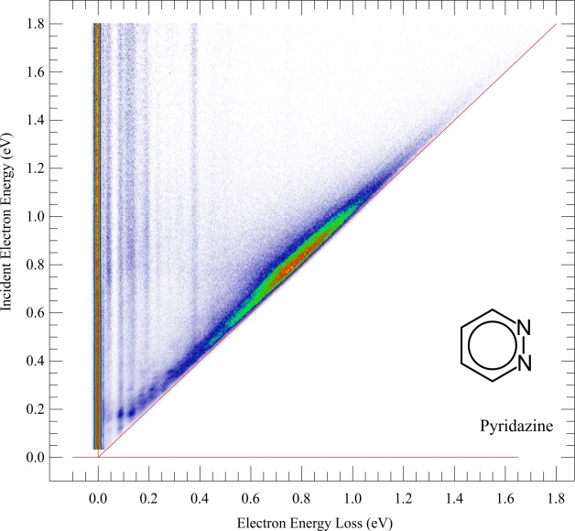
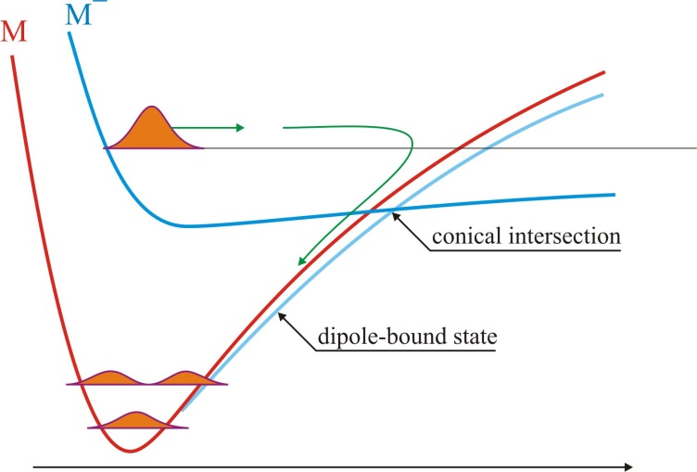
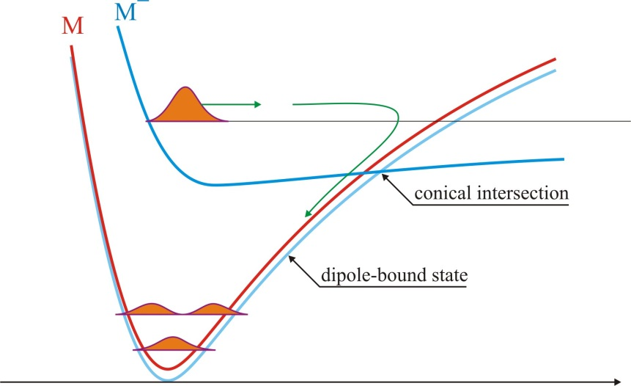
Role of dipole moment
μ = 0 D
μ = 2.3 D
μ = 4.0 D
<number>
<number>
Notes:
<number>
<number>

Slide 30
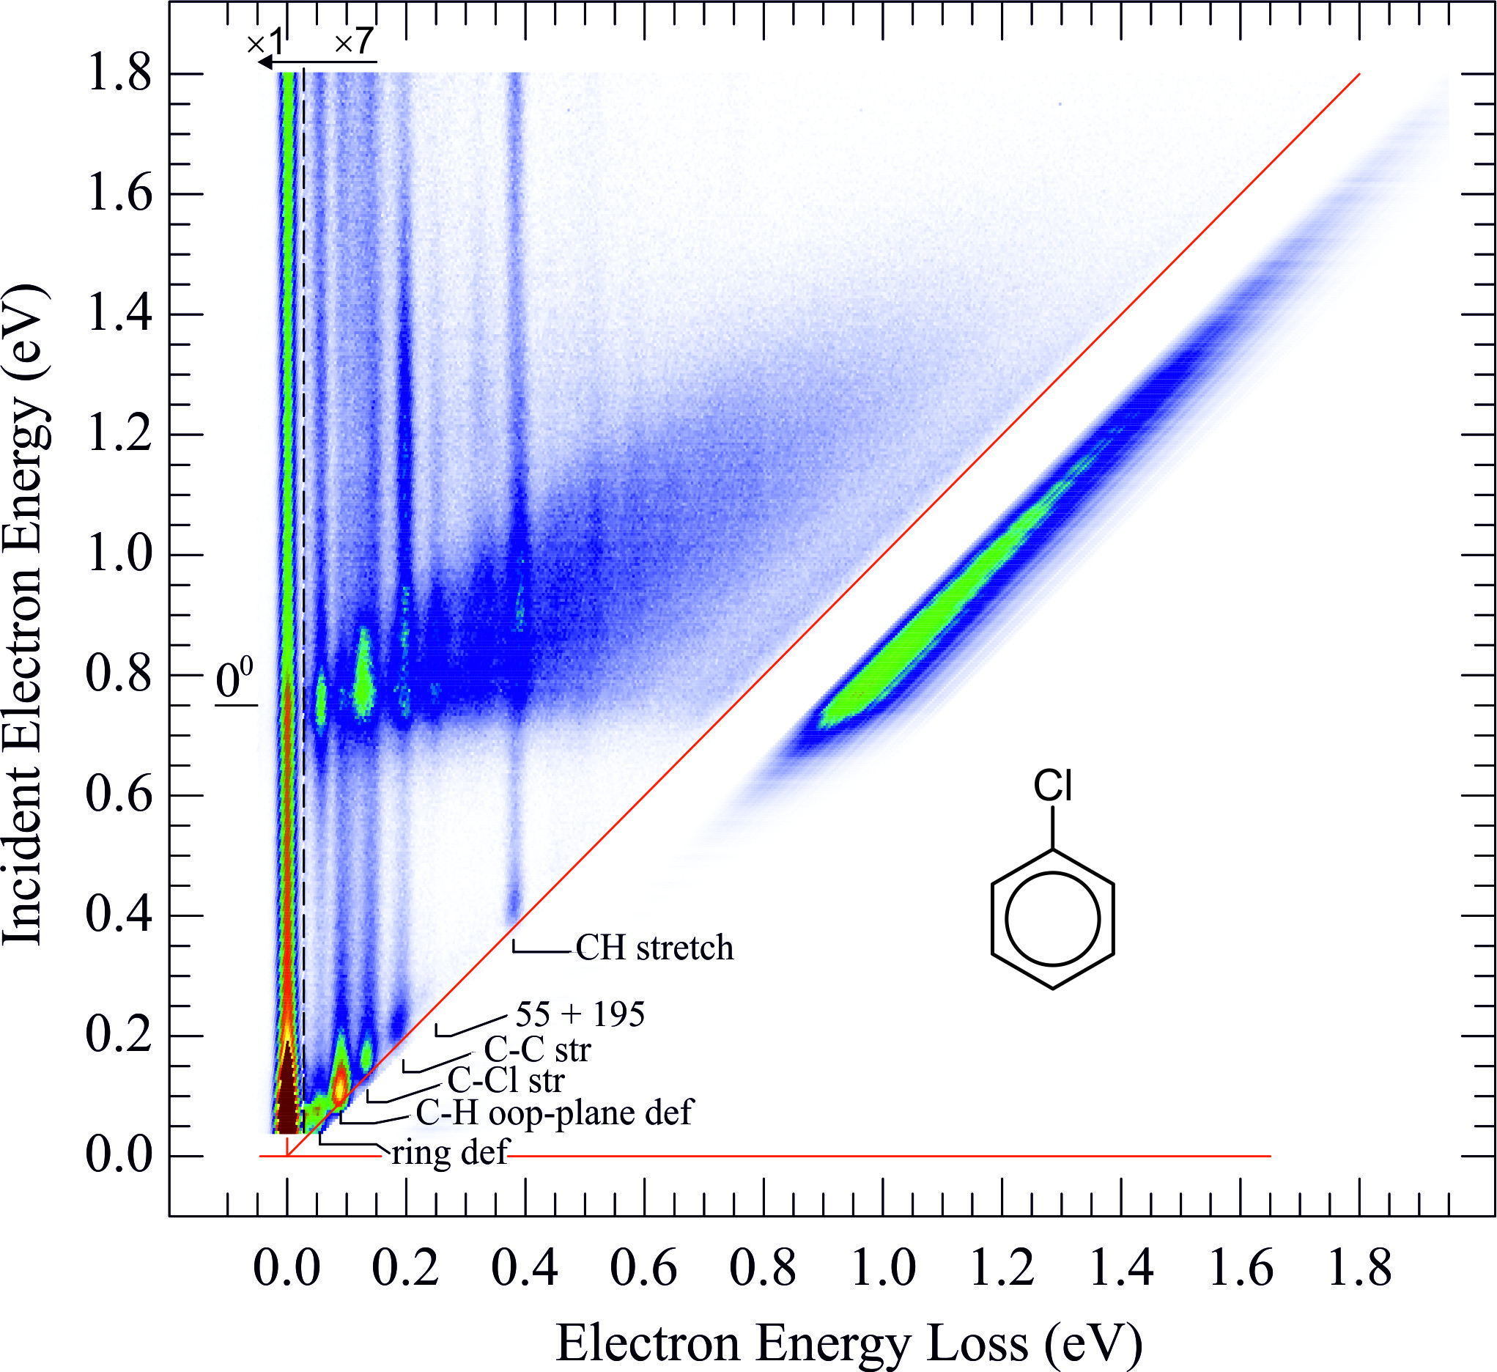
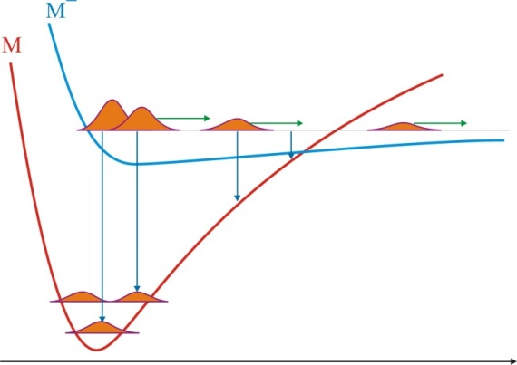
open the dissociation channel
ion yield
<number>
<number>
Notes:
<number>
<number>

Slide 31
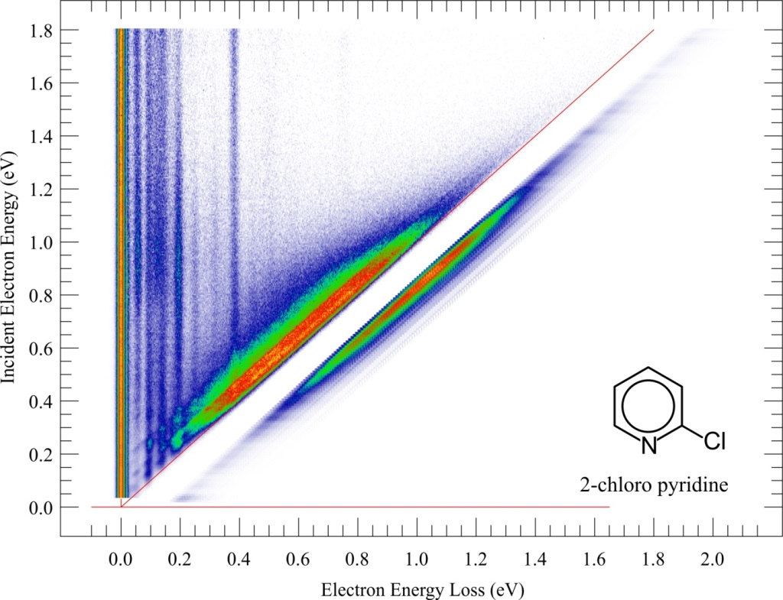
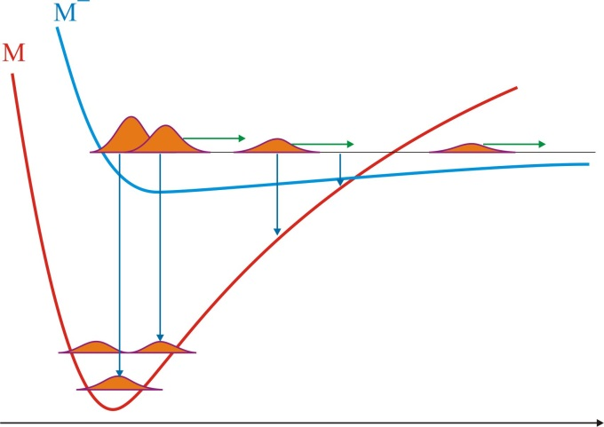
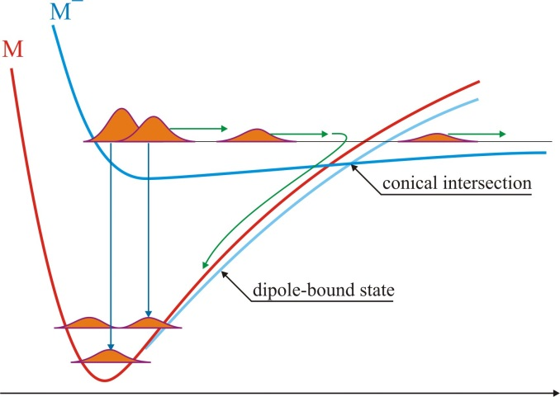
Role of dipole moment: the two mechanisms of Dissociative Electron Attachment
μ = 3.7 D
μ = 0.3 D
Dissociation by sliding on a potential surface
Thermal dissociation after passing a conical intersection
<number>
<number>
Notes:
<number>
<number>

Slide 32
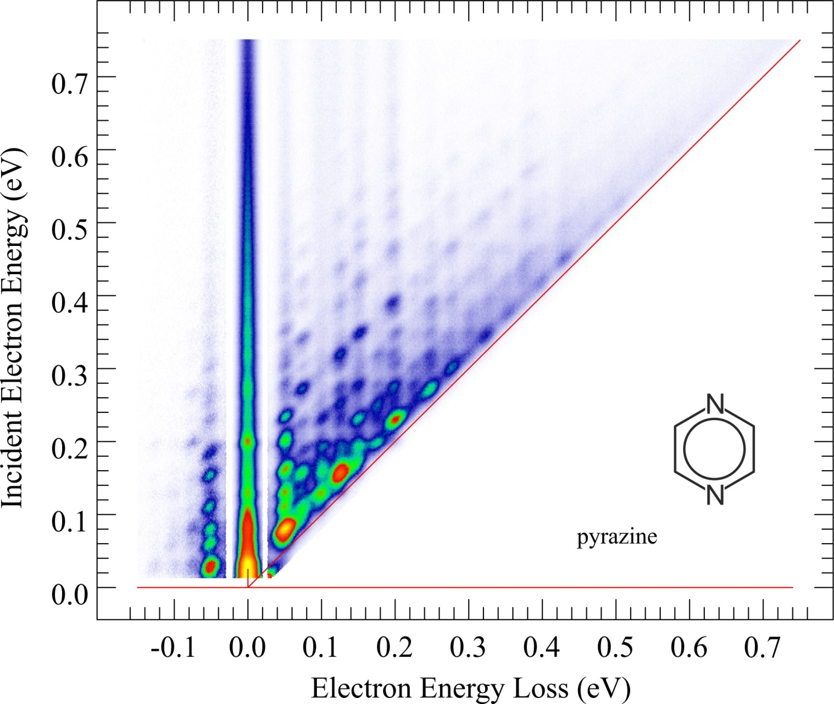
THE END
<number>

Slide 33
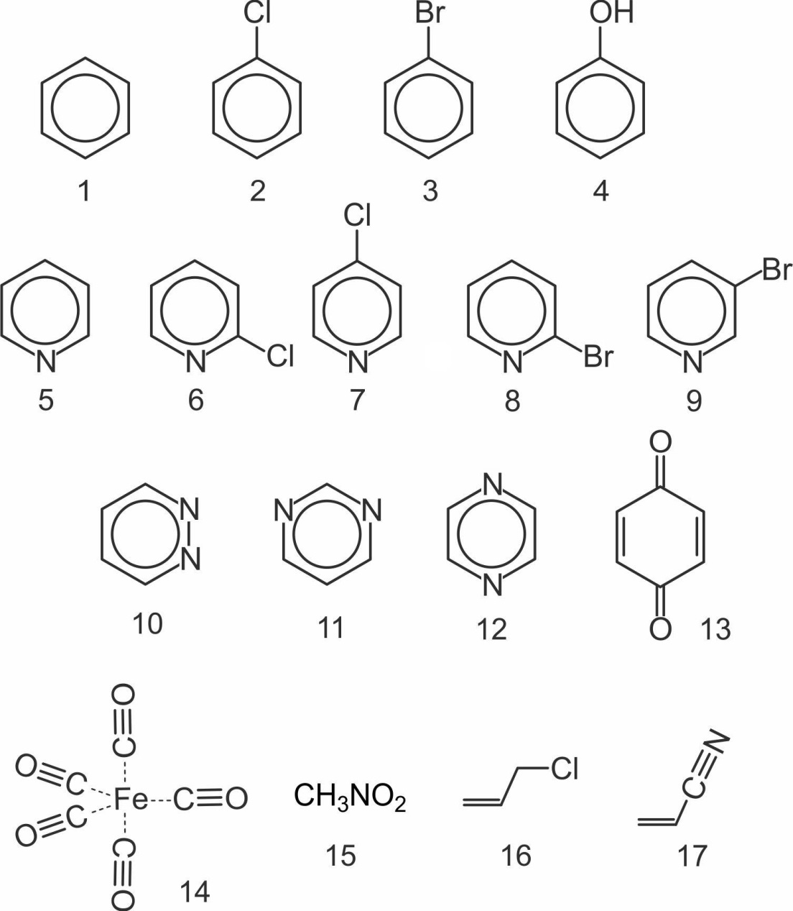
published
<number>
<number>
Notes:
<number>
<number>

Slide 34
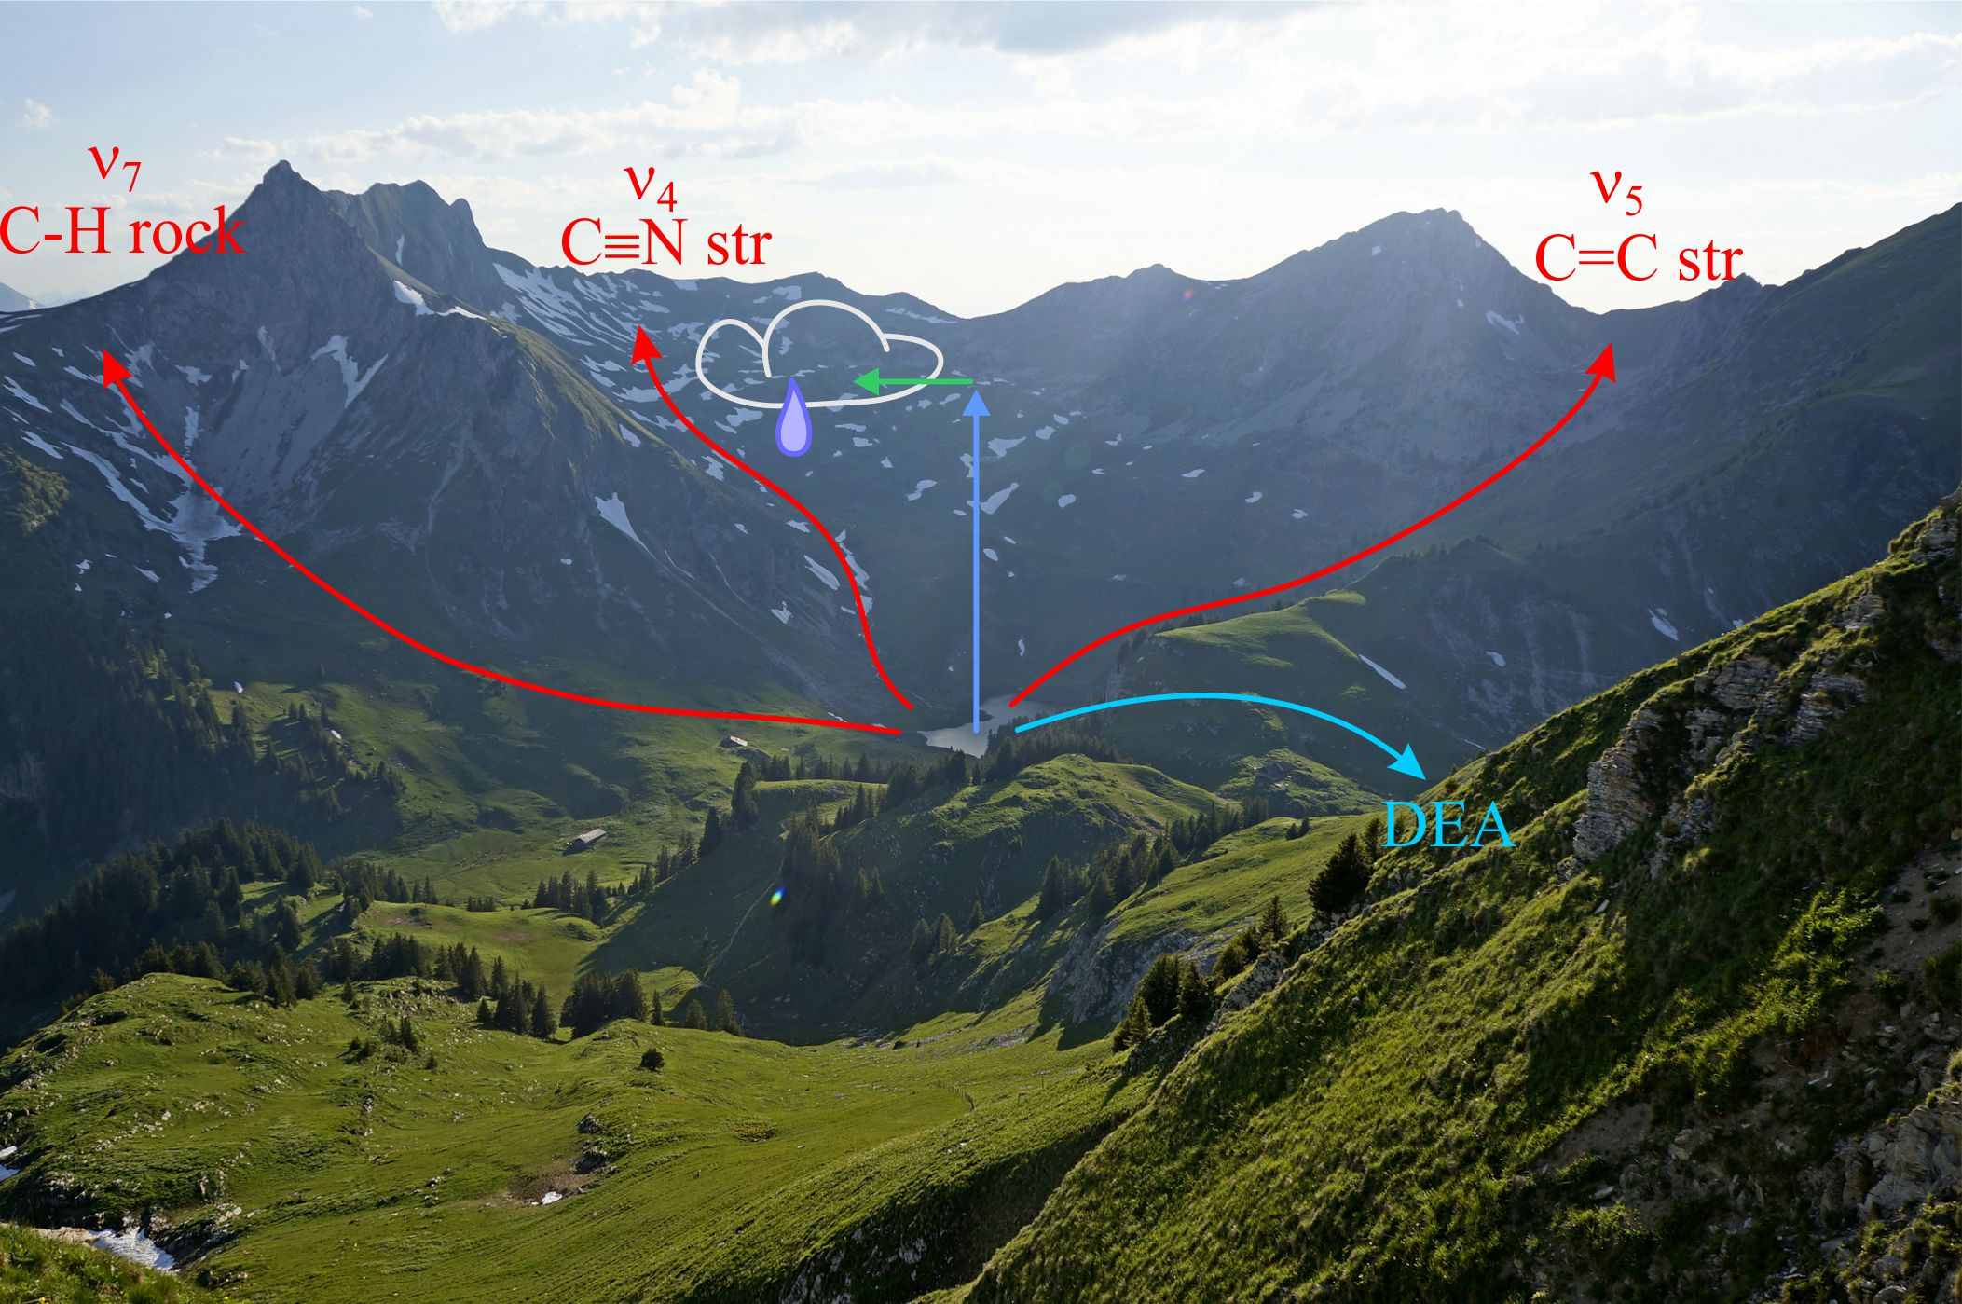
<number>
<number>
view from Widdergalm towards Rotenchaste
Notes:
<number>
<number>

Slide 35

Island of
specific excitation
Elastic ridge
Cloud
Threshold line
Direct excitation of IR active modes ?
(Born correction)
Threshold peaks
<number>
<number>
Notes:
<number>
<number>

Slide 36
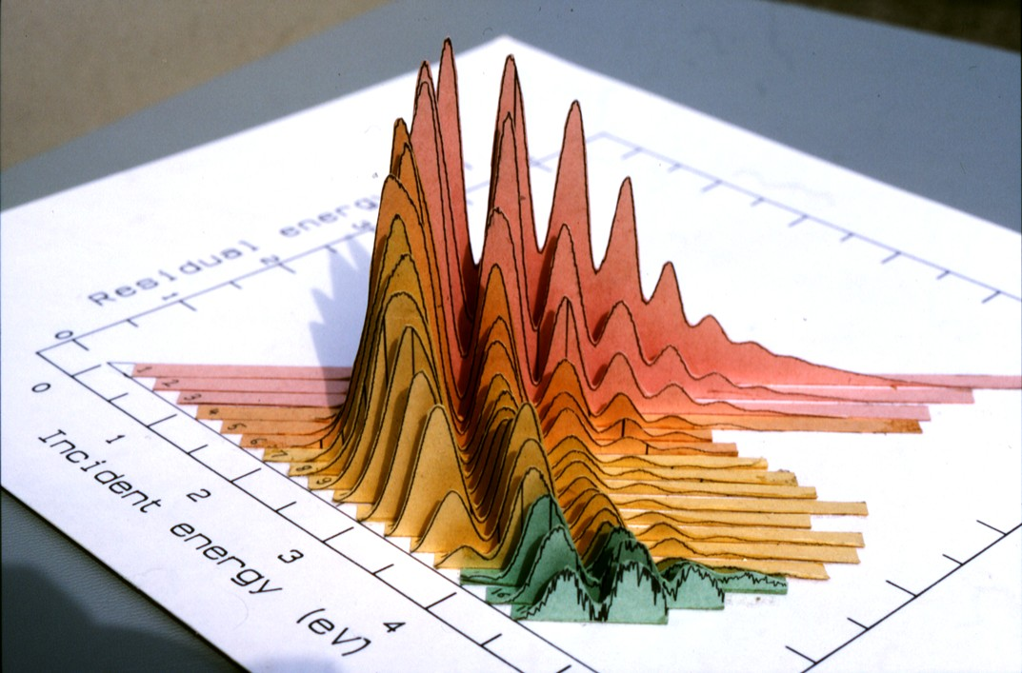
2-D spectra
Fribourg 1985
<number>
<number>
Notes:
<number>
<number>

Slide 37
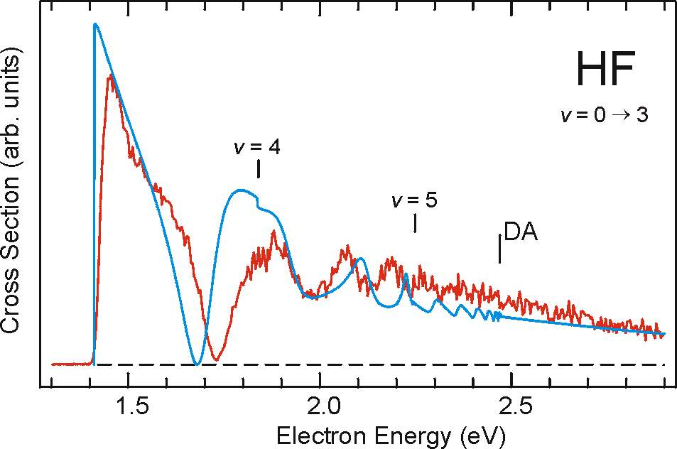
HF – theory and experiment
Čížek, Horáček, Allan, Fabrikant, Domcke, J. Phys. B (2003)

Slide 38
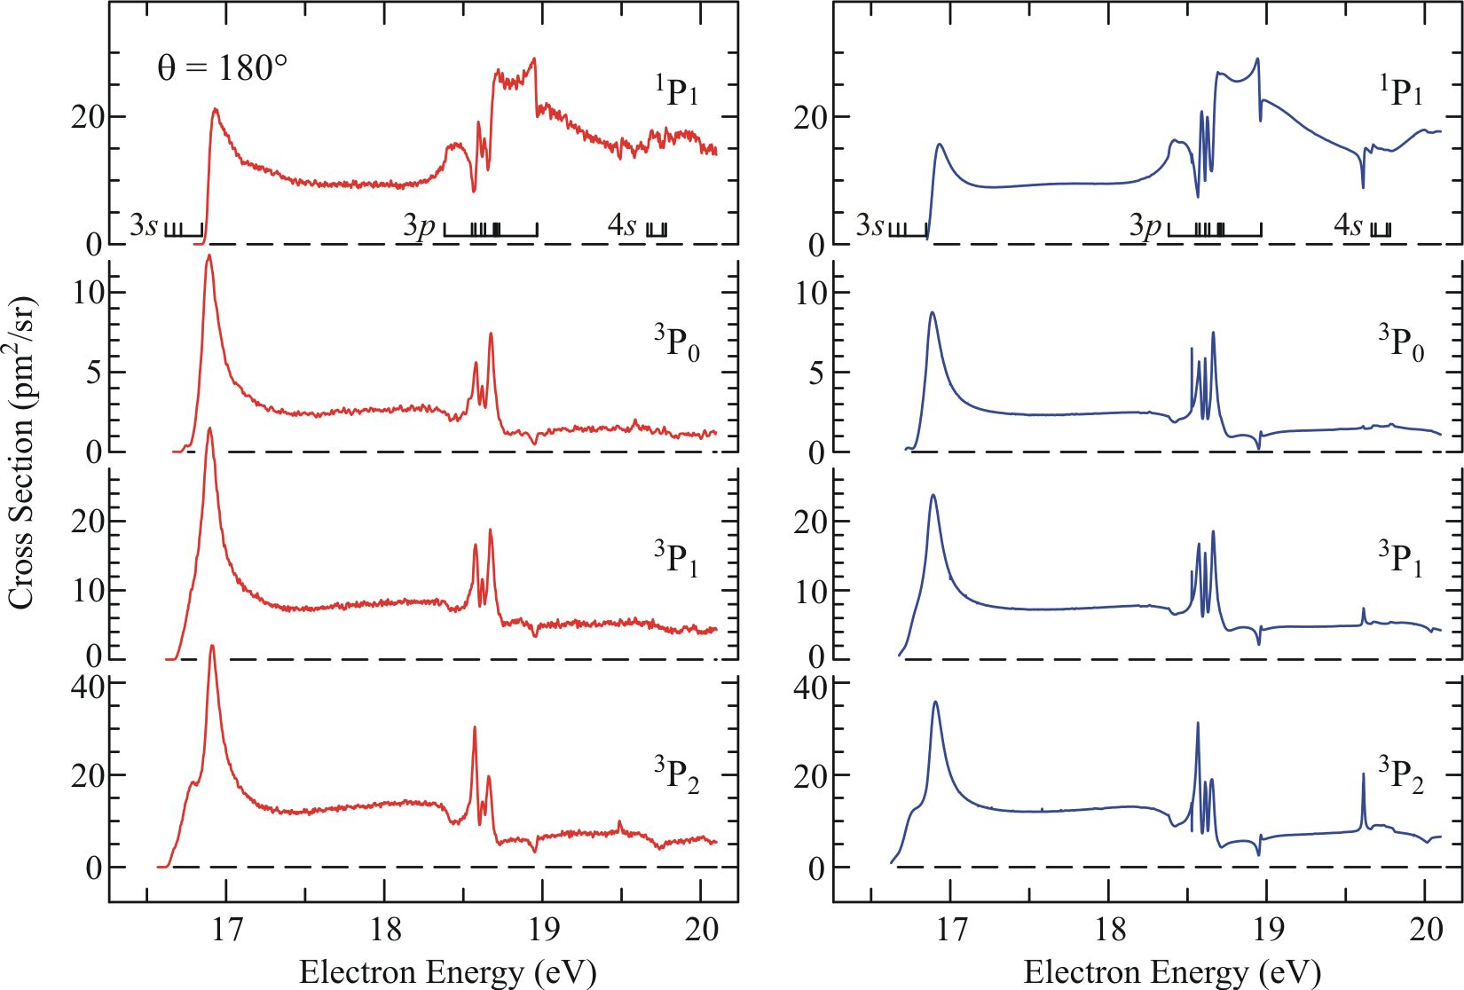
Ne
Absolute cross sections for excitation of the Ne (2p⁵3s) states at θ = 180°.
M Allan, K Franz, H Hotop, O Zatsarinny and K Bartschat 2008

